Slide 1
Leveraging Innovative Solutions for eGovernment
Sade Dada, Esq.
Public Policy Manager, Anglophone West Africa
Connectivity & Innovation Policy Manager, Africa
Meta Platforms, Inc.
Nigeria eGovernment Summit 2023
September 28, 2023

Slide 2
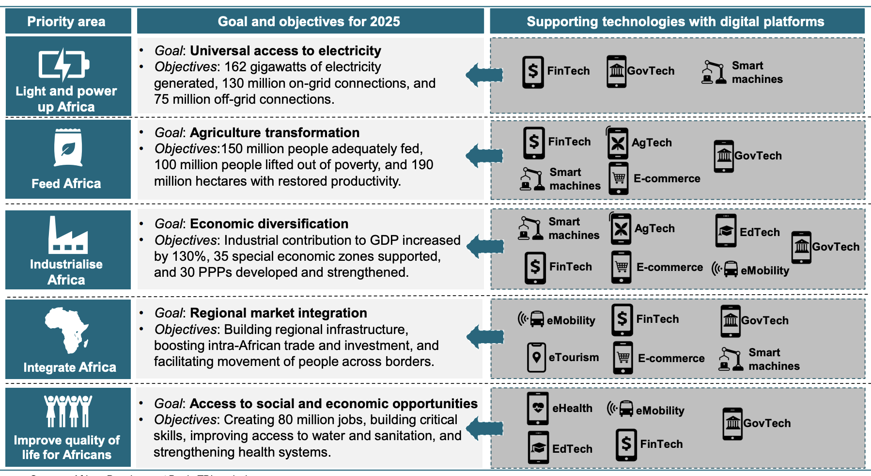
How Tech Can Accelerate Nigeria’s Development
African Development Bank’s High 5 priority areas for transforming Africa (African Development Bank, The Tony Blair Institute)
Notes:
African Development Bank’s High 5 priority areas for transforming Africa are dependent on tech and digital platforms.

Slide 3
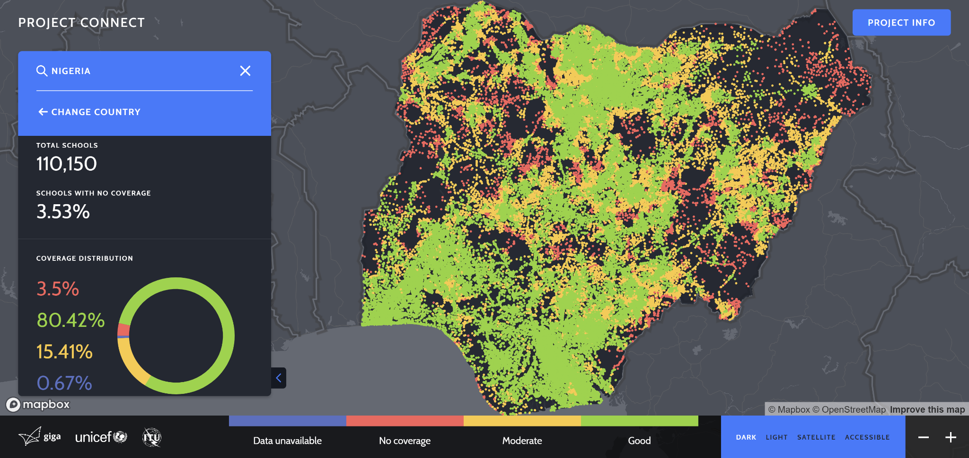
Leveraging Tech & Digital Platforms for eGov Services
UNICEF/ITU Project Giga School Connectivity Initiative
Government should leverage trend of utilizing tech and digital platforms such as social media, artificial intelligence, data analytics, fintech, etc to accelerate the rollout of egov services
Data for Good
Population density, electrification, connected schools
Public/government facilities to support digital economy: Example of Ministry of Communications, Innovation, and Digital Economy NIPOST reform
Powered by Meta network connectivity data

Slide 4
The Nigeria Integrated Energy Planning Tool used Meta’s High Resolution Settlement Layer (Population Density Map) as a key input layer

Slide 5
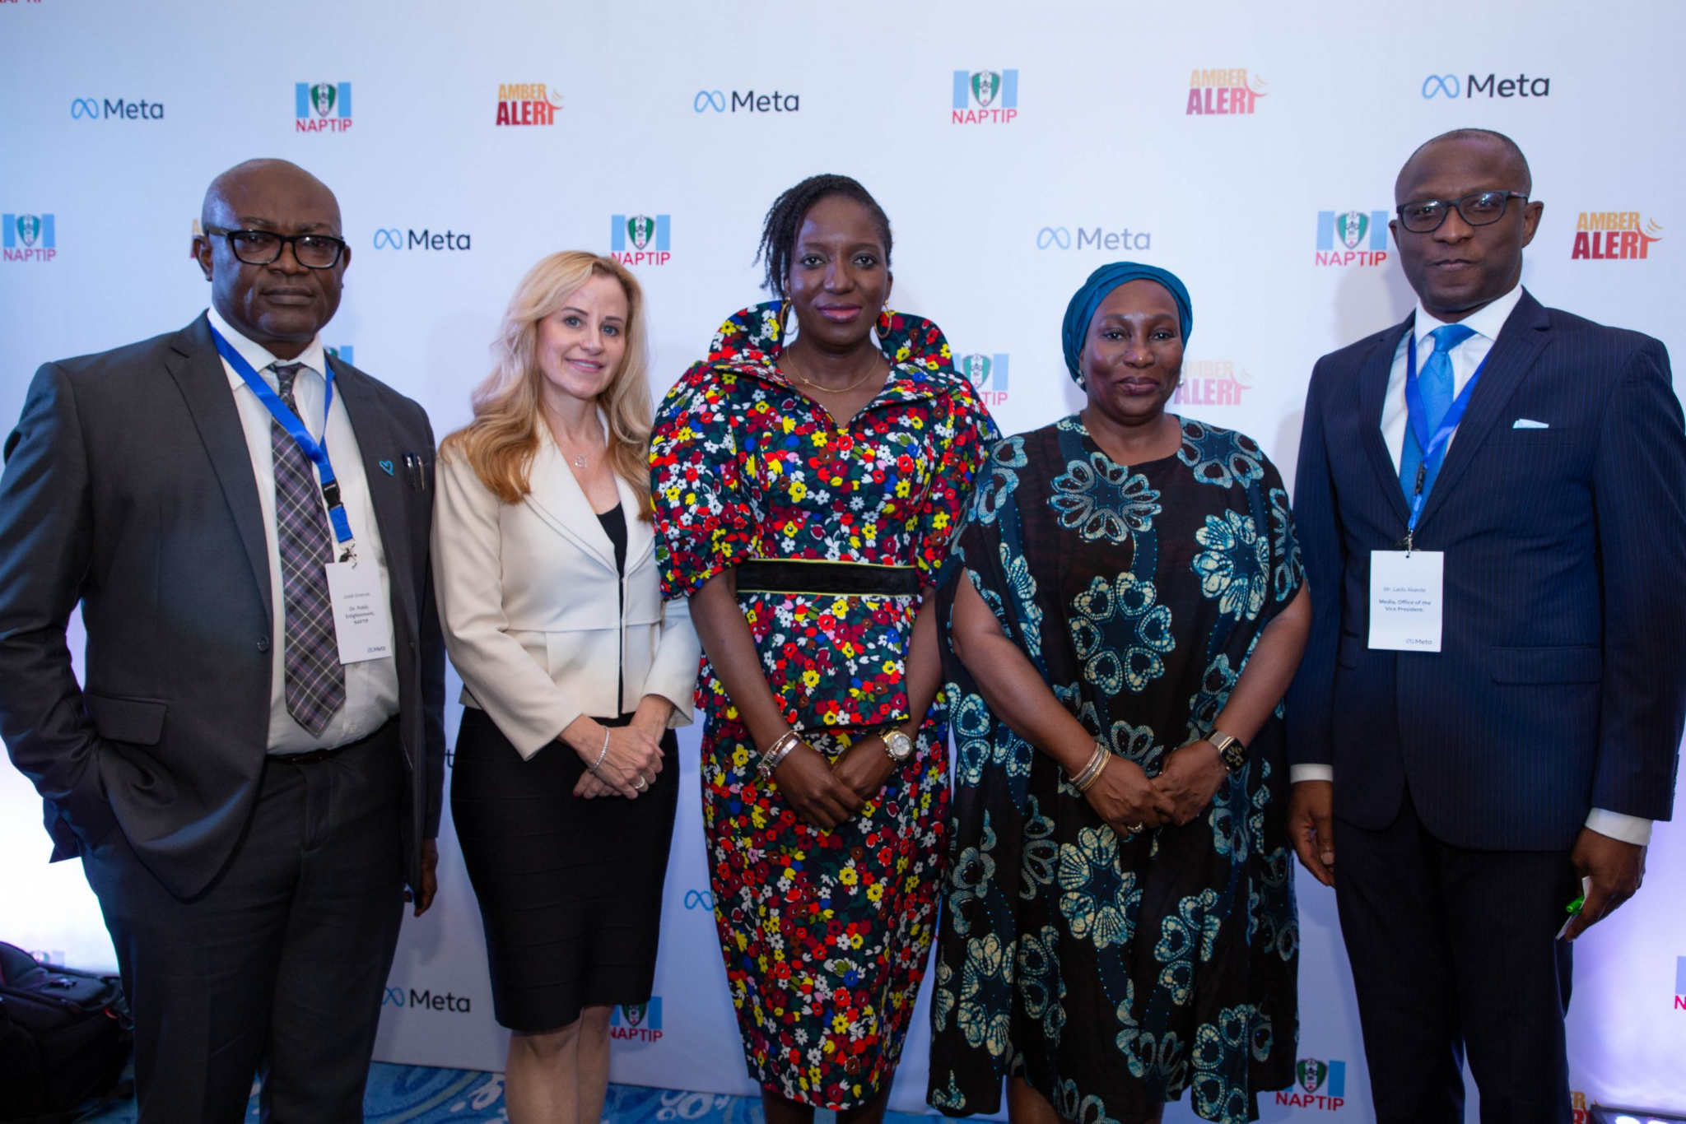
Leveraging Platforms for Communicating & Optimizing Government Work
Facebook & Instagram
Meta & National Agency for the Prohibition of Trafficking in Persons (NAPTIP) launched Amber Alerts on Facebook and Instagram
Public Health and Crisis Response (ex. COVID outreach)
Workplace: All-in-one business communication platform from Meta that securely combines chat, video, groups and your intranet with the work tools you already use.
WhatsApp Channels: one-way broadcast tool for organisations to share valuable and timely information

Slide 6
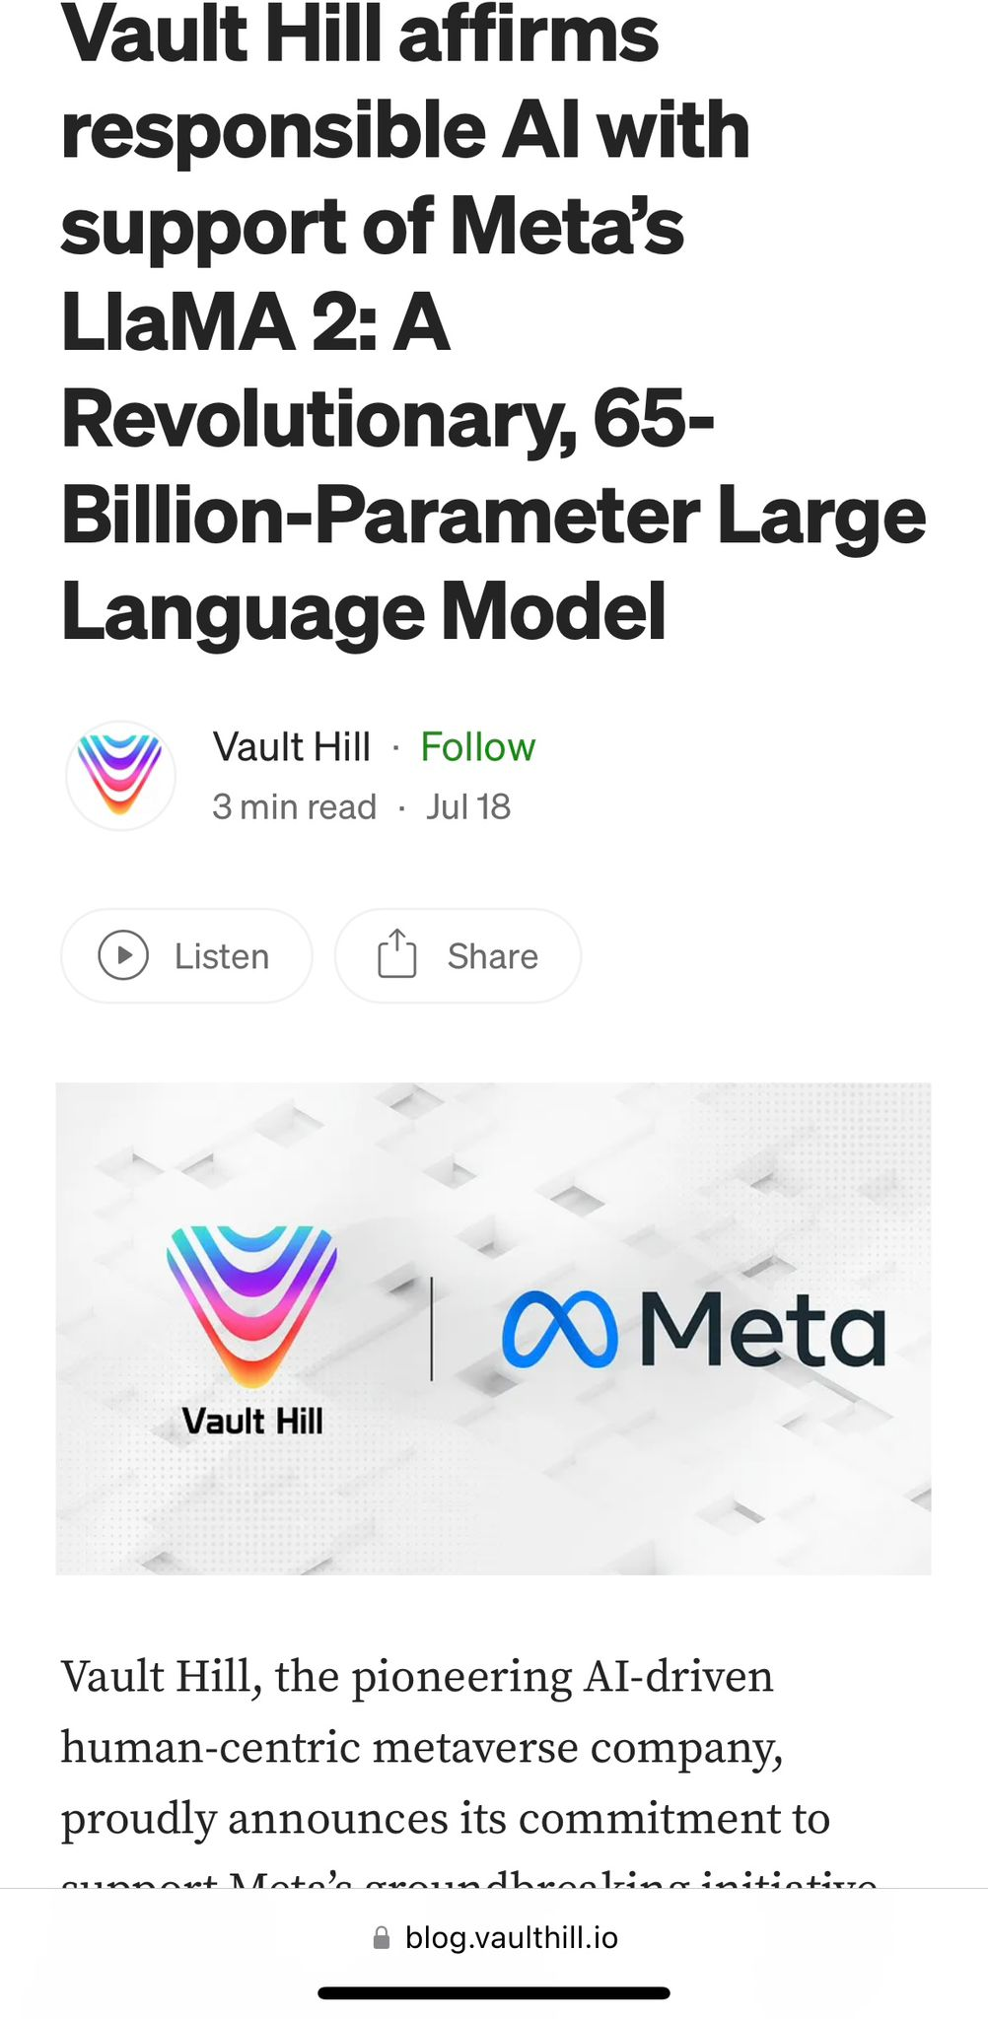
Statement of support for Meta’s open approach to today’s AI
“We support an open innovation approach to AI. Responsible and open innovation gives us all a stake in the AI development process, bringing visibility, scrutiny and trust to these technologies. Opening today’s Llama models will let everyone benefit from this technology.”

Slide 7
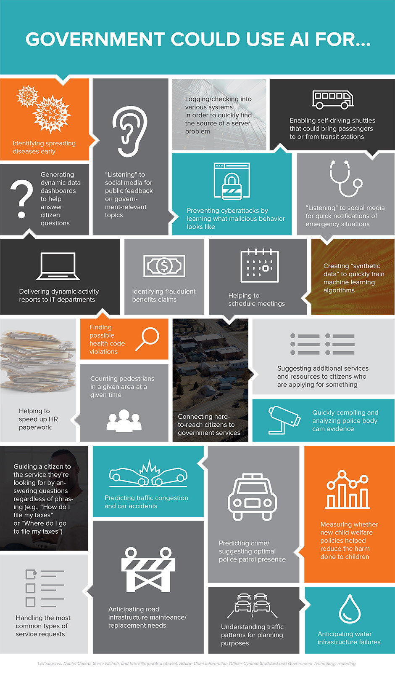
AI & Metaverse for eGovernment Solutions
Notes:
We use AI at Meta for a multitude of things.

Slide 8
RESPONSIBLE INNOVATION
Privacy, Security, Accountability & Governance
Key Principles of Responsible AI:
Privacy, Security, Accountability & Governance:
Build reliable processes to ensure accountability for AI systems and their outputs
8 Privacy Expectations: Purpose Limitation, Data Minimization, Data Retention, External Data Misuse, Transparency & Control, Data Access & Management, Fairness, and Accountability
Partnerships & Collaborations
Fairness & Inclusion:
Fairness is central to responsible AI
AI-driven systems may affect people in diverse groups, or groups that have been historically marginalized in society
Robustness & Safety:
Test how robust AI-powered integrity systems are against adversarial threats
Transparency & Control:
Develop tools and techniques to explain how products work, and enable users to exercise control over how they experience them
Open Science/Open Sourcing
Responsible AI
Fairness & Inclusion
Robustness & Safety
Transparency & Control

Slide 9
Network
Graphics
Compute
Wireless
5G
5G
Input
Edge Compute
DEVICES
CONNECTIVITY
Haptics
Fiber
_{METAVERSE & AI}
ECOSYSTEM
Displays
Form Factors
Zero Latency
Dev Tools
Education
Device OS
Developers
Payments
CREATORS
PLATFORMS
Commerce
Fashion
Cloud
Identity
Builders

