Slide 1
The Nigeria eGovernment Summit 2023
Critical National Infrastructure & Cybersecurity Panel: Policy Protection for Infrastructure Investment and Web Safety
Presented by - Soji Maurice-Diya (Chief Operating Officer, ATC Nigeria)
© 2022 ATC IP LLC. All rights reserved.

Slide 2
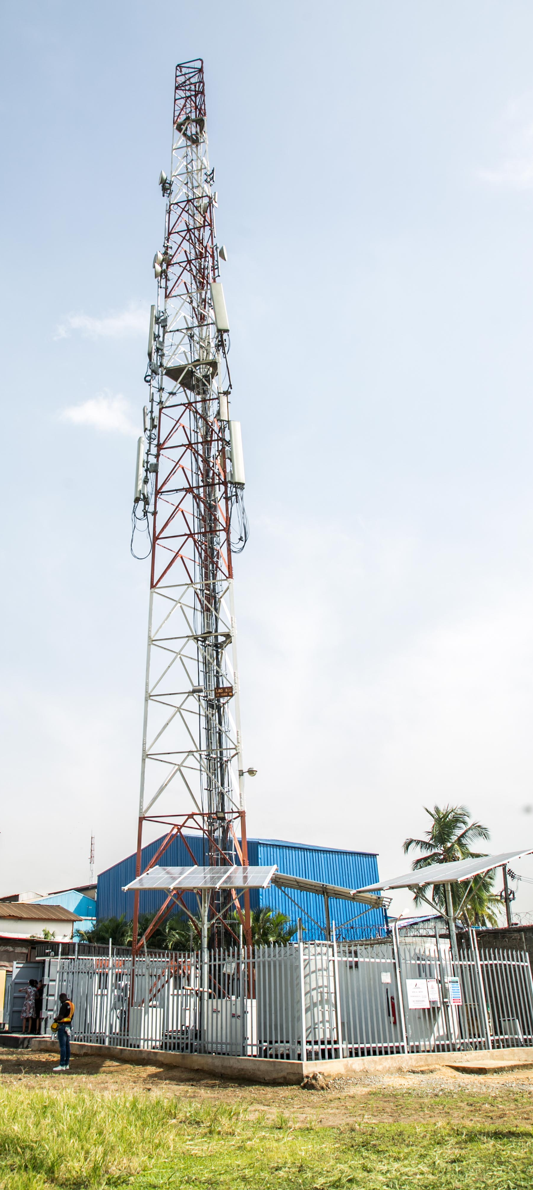
Policy Protection for Infrastructure Investment and Web Safety affects all of us!
Telecommunications infrastructure, or wireless and cellular infrastructure, is now integral to daily life, business, and government purposes. These towers enable us to stay connected with each other via smartphones, internet, and so forth. More investment is required to bridge the telecom infrastructure gap in the country to meet coverage and capacity requirements for seamless web access and surfing
Web safety also known as Internet safety, online safety, cyber safety and electronic safety (e-safety), is the act of maximizing a user's awareness of personal safety and security risks to private information and property associated with using the Internet, and the self-protection from computer crime
Vast majority of people use ICT/telecommunications infrastructure for legitimate purposes. Therefore, a deliberate policy framework that safeguards and guarantees security and protects fundamental rights and safety telecom infrastructure needs to be put in place by the federal government

Slide 3
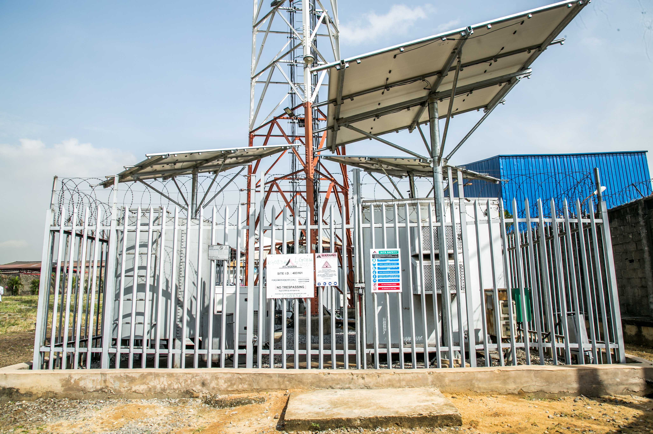
Why worry about Policy Protection for Infrastructure Investment and Web Safety?
Web Safety
Opportunities provided by information communication technologies (ICT)
Information society: where is your private life taking place?
Confidentiality, integrity, and availability of your computer data
Reliance of public and private establishments infrastructure on ICT
Vulnerability to cybercrime
Need for secure and accessible ICT platforms
Infrastructure Investment
Telecommunications infrastructure is the primary structure that Mobile Network Operators depend on to provide GSM network services to their subscribers
Vandalism and unlawful sealing of telecommunication infrastructure compromises Quality of Service
Loss of revenue to operators

Slide 4
Policy Framework for Protection of Investment Infrastructure and Web Safety
THE CYBERCRIME ACT 2015 “ACT”
The Act makes provision for the President on the recommendation of the National Security Adviser, by Order published in the Federal Gazette, designate certain computer systems, and/or networks, whether physical or virtual, and/or the computer programs, computer data and/or traffic data vital to this country that the incapacity or destruction of or interference with such system and assets would have a debilitating impact on security, national or economic security, national public health and safety, or any combination of those matters as constituting Critical National Information Infrastructure (“CNI”).
THE LEGISLATIVE RESPONSE
The legislation criminalizes specific techniques/technologies or conduct including the process for the declaration of telecommunications/Information and Communication Technology assets as CNI.

Slide 5
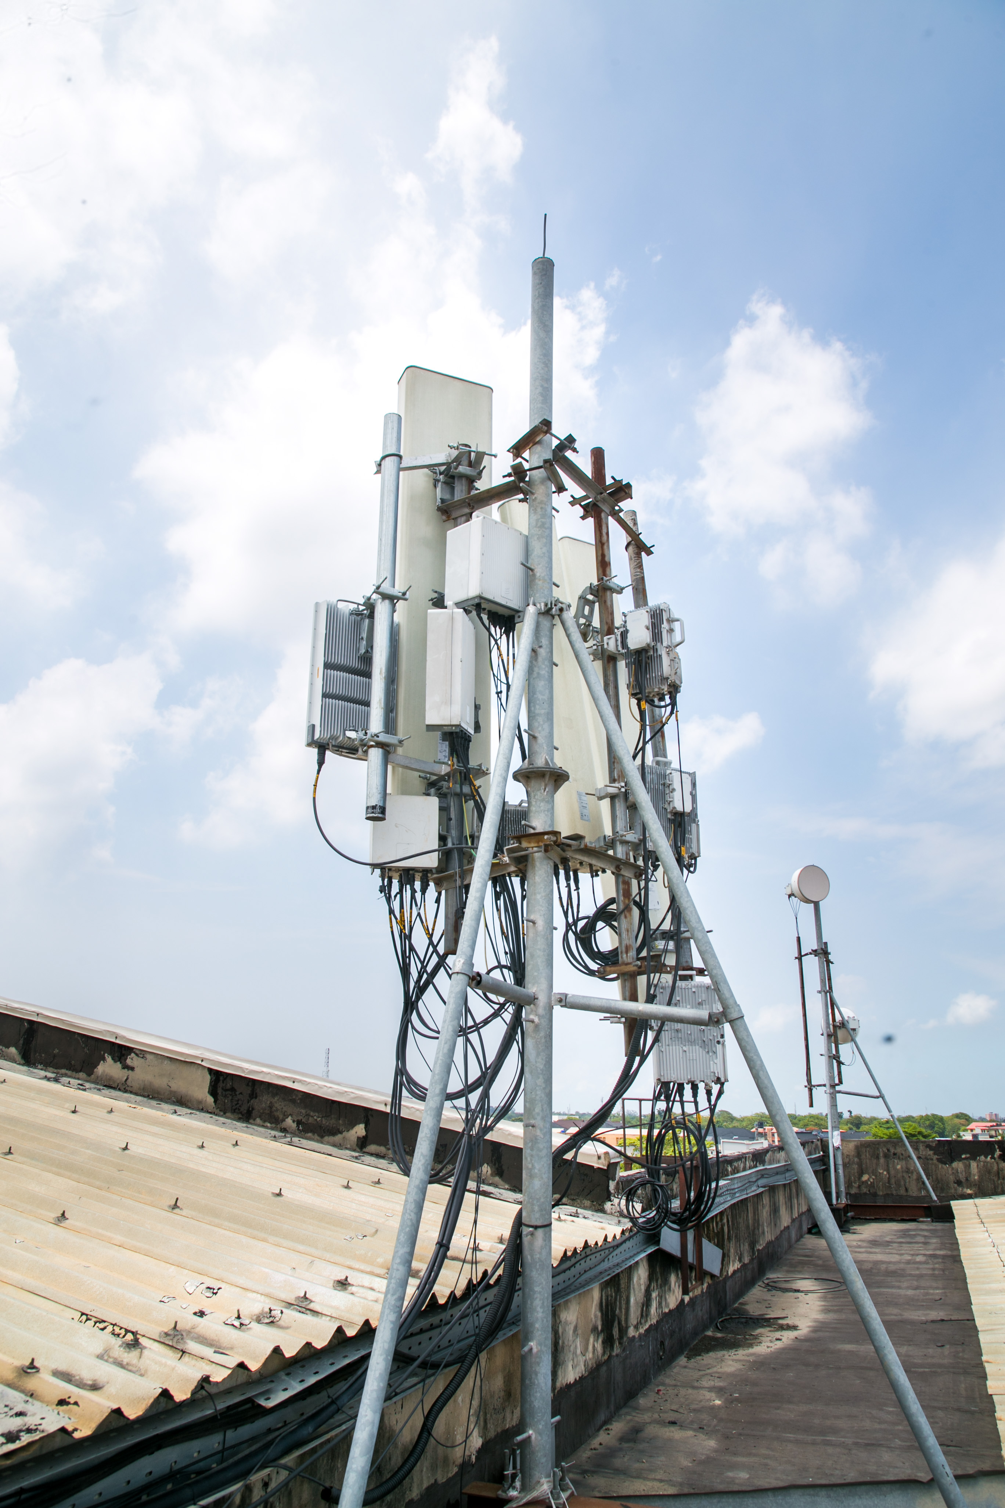
Web Safety Covered by the Act
Offences against computers
Offences against the confidentiality, integrity and availability of computer data and systems
Illegal access to a computer system
Illegal interception
Data interference
System interference
Misuse of devices
Offences through computers
Computer-related forgery and fraud
Content-related offences (child pornography, xenophobia, racism)
Offences related to intellectual property rights and similar rights

Slide 6
THE GAPS CREATED UNDER THE ACT
Offences relating to telecom infrastructure are not covered under the Act. Such offences include:
Willful denial of access to telecommunications infrastructure
Unlawful damaging of telecommunications infrastructure

Slide 7
Reasons For Urgent Need For the Designation of Telecom Infrastructure as CNI
Because INVESTMENT is a COWARD; it does not thrive in an atmosphere of anarchy and disorder. A Declaration of telecommunication infrastructure as CNI is urgently needed.
The ICT sector, driven by the telecommunications industry, contributed N2.508 trillion in Q1, 2023 representing 14.13% of GDP.
Figures released by the National Bureau of Statistics (NBS) showed the sector recorded a 4.3% increase (up from 13.55% of Q4 2022).
The telecommunications industry is amongst the sectors that lifted the country out of recession in Q4 2020, contributing 12.45% to the country’s GDP.
The telecommunications sector has been a major driver of the digital economy agenda of the Federal Government in the last 5 years and it continues to provide the digital sinews that support the economy, especially during the COVID-19 pandemic.
Telecommunications infrastructure despite its importance, is frequently exposed to destabilizing acts like fibre cuts/sabotage, access denial etc., that result in network congestion, poor voice/data service quality and significant revenue loss for operators.
This ugly trend in the most successful sector of the country will continue unabated unless the telecommunications infrastructure is declared as CNI.
The designation will deter vandals, host communities, tax agencies and other government MDAs from wanton destruction and unlawful denial of access to the telecom infrastructure.
Attract more investment to the sector.

Slide 8
RECOMMENDATIONS:
Short Term
Issuance of Executive Order by the President designating telecommunications infrastructure as CNI in line with provisions of the Cybercrimes Act 2015
Lead Agency
URGENT NEED FOR THE DESIGNATION OF TELECOM INFRASTRUCTURE AS CNI
In either case,
need to designate a lead agency
to coordinate and manage protection of CNI in line with international best practices
Long Term
Enact legislation designating
telecommunications infrastructure
as CNI

Slide 9
Thank You!

