Slide 1
Financial Inclusion and Data Protection as a Fundamental Human Right
BY
FEMI WILLIAMS FNCS
Bridging the Gap for Economic Empowerment

Slide 2
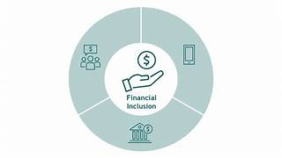
Definition
Financial inclusion refers to the accessibility and availability of essential financial services and products to all segments of society.
These services and products typically include savings accounts, payment and money transfer services, credit, insurance, and access to financial education.
Access to Banking Services
Affordability
Accessibility
Financial Literacy
Credit and Lending
Insurance
Digital Financial Services

Slide 3
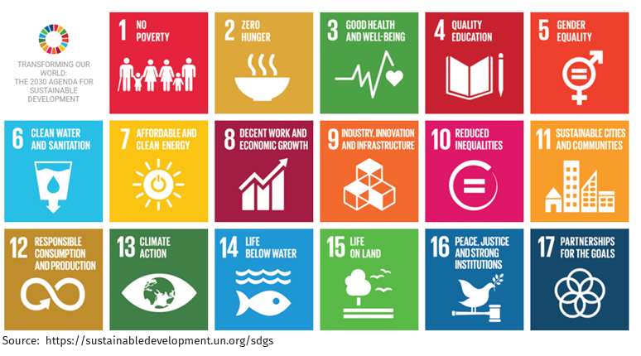
UN Sustainable Development Goals
Financial inclusion, a critical factor in reducing poverty, promoting economic development, and fostering social inclusion.

Slide 4
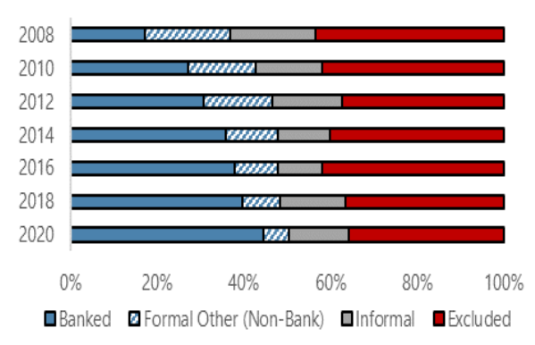
Financial Inclusion In Nigeria
Sources: World Bank Group (2021) and EFInA (2021a)

Slide 5
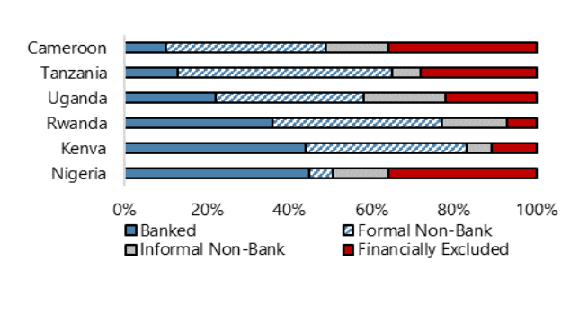
Financial Inclusion In The Region
Sources: World Bank Group (2021) and EFInA (2021a)

Slide 6
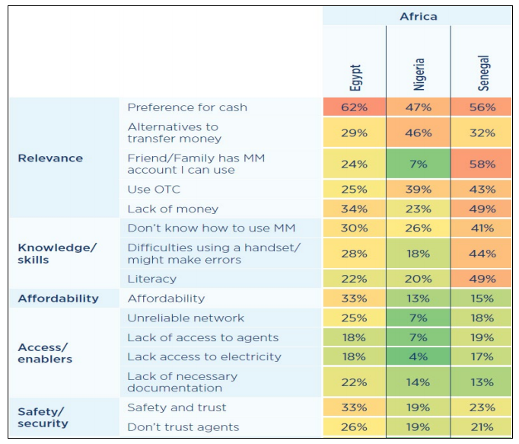
NIGERIA: Reasons For Not Having Mobile Money Account

Slide 7
EFFORTS
National Financial Inclusion Strategy (NFIS 3.0) - 2015
National FinTech Strategy
Strategy for Leveraging Agent Networks to drive women's Financial Inclusion
Payment System Vision 2025
SANEF
CBDC (eNaira)
Cashless
Cash Withdrawal
Licenses: PSB, MNO
Kaduna/Lagos States

Slide 8
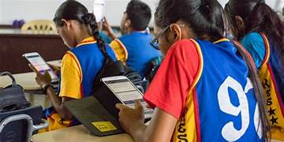
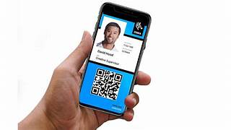
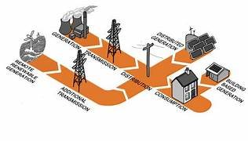
Foundation Infrastructure For Financial Inclusion
CONNECTIVITY
CYBERSECURITY
DATA PRIVACY
DIGITAL & FINANCIAL LITERACY
INTEROPERABILITY
DIGITAL ID
FAIR COMPETITION
PHYSICAL INFRACTRUCTURE

Slide 9
Data Protection
Right not to be subject to automated decision making
Right to data portability
Right to object to processing
Right to withdraw consent
Right to erasure
Right to rectification
Right to restriction of processing
Right to complain
NIGERIA DATA PROTECTION ACT, 2023
Nigeria Data Protection Commission
National Commissioner
“safeguard the fundamental rights and freedoms, and the interests of data subjects, as guaranteed under the Constitution of the Federal Republic of Nigeria, 1999”
Higher of ₦2million or ₦10million and 2% of annual gross revenue in the preceding financial year

Slide 10
Why is Financial Inclusion considered as Fundamental Human RIght
Poverty Reduction
Income Equality
Access to Basic Services
Social Inclusion
Protection from Exploitation
Dignity and Choice
Participation in Formal Economy
Human Rights Framework
1
2
3
4
5
6
7
8

Slide 11
Conclusion
Nigeria Has achieved major growth but less than the projected
Need More Education
(Financial Literacy)
Innovation
Regulation
More Empowerment (especially for Women)
Aggressive Roll Out (especially Northern)

Slide 12
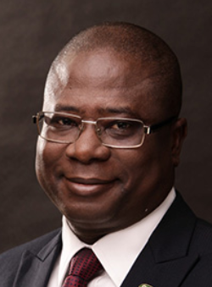
Thank
you
Femi Williams
Chief Enabling Officer
IT, Strategy and General Consultancy Services
NewWaves Ecosystem Limited
220B, Eti Osa Way
Ikoyi, Lagos.
M: 08033046408
E: williamsos@newwavesecosystem.com

