Slide 1


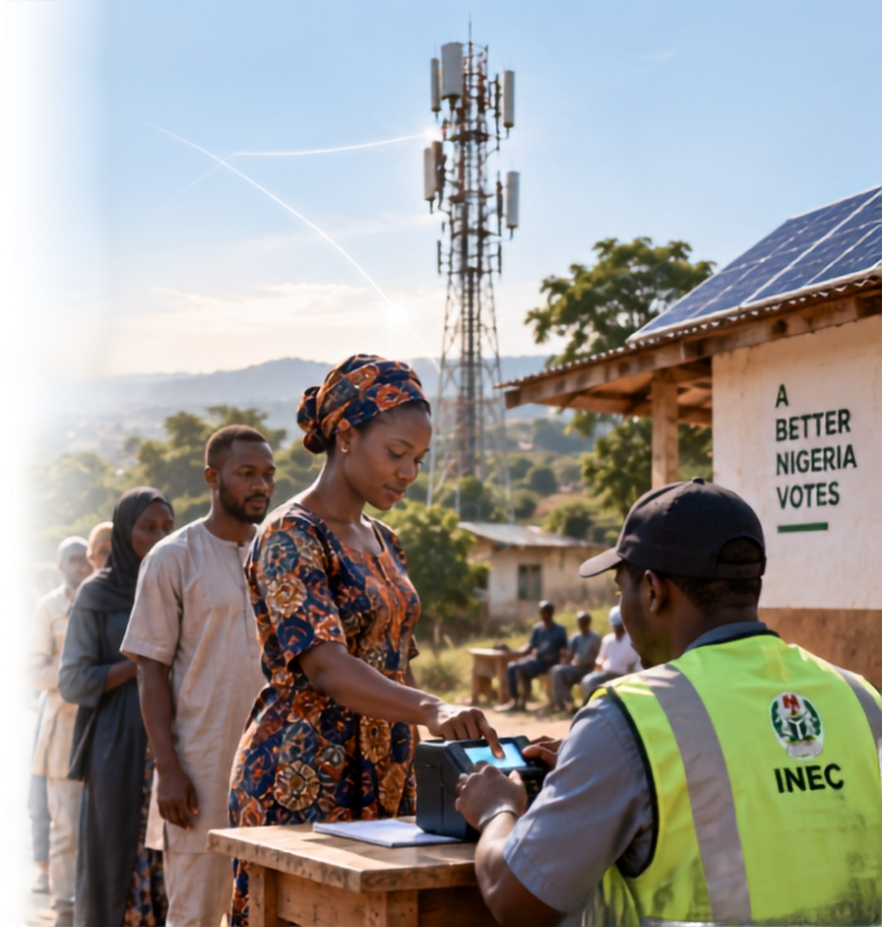







THENIGERIA EGOVERNMENT SUMMIT 2026
Digital Infrastructure, Energy & Inclusive Access
The Last Mile Challenge: Powering Connectivity and Energy for 100% Polling Unit Coverage
Adewumi Anjorin
Founder & Managing Director, LinkOrg Networks Ltd
10 September 2026
Radisson Blu, Ikeja, Lagos

Slide 2




Election Technology Succeeds or Fails at the Last Mile
Digital election systems depend on four conditions working together at the polling unit
1
IDENTITY
2
CONNECTIVITY
3
ENERGY
4
TRUST
BVAS can authenticate the voter
The device can reach the required service
Power lasts through accreditation and result upload
Evidence remains available, secure and auditable
100% coverage means verified availability, not a coloured area on a network map
8th Nigeria eGovernment Summit | 10 September 2026
Notes:
Explain that digital identity, connectivity, energy and trust form one operating system. Failure in any one layer creates queues, delayed uploads, inconsistent procedures and public doubt.
Sources:
https://wp1.inecnigeria.org/wp-content/uploads/2023/02/2023-Election-Procedure-1.pdf

Slide 3


The Scale of the National Assignment
176,000+
93 million+
23.37m
polling units across the federation
registered voters shown by INEC
people in 87 unserved or underserved ICT clusters
62.5%
of Nigeria's population had access to electricity in 2024
National averages hide the weak-grid and off-grid locations where election systems face the greatest risk
8th Nigeria eGovernment Summit | 10 September 2026
03
Notes:
Set the scale. INEC currently displays more than 176,000 polling units and more than 93 million registered voters. USPF's 2024 study identified 87 ICT gap clusters containing 23.37 million people. World Bank data reports 62.5 percent electricity access in 2024.
Sources:
https://inecnigeria.org/
https://www.uspf.gov.ng/clusters-of-ict-gap
https://api.worldbank.org/v2/country/NGA/indicator/EG.ELC.ACCS.ZS?format=json&per_page=10

Slide 4

The Polling-Unit Service Chain Has Several Failure Points
1
2
3
4
5
DEVICE
RADIO
BACKHAUL
PLATFORM
PUBLIC RECORD
Battery, software, SIM
Signal strength, congestion
Microwave, fibre, satellite
Authentication and result services
IReV access and audit
A device can authenticate offline, yet the public still experiences a failure when results upload, visibility or support breaks later in the chain
8th Nigeria eGovernment Summit | 10 September 2026
05
Notes:
Walk across the chain. A narrow focus on the handheld device misses radio congestion, backhaul failure, platform capacity and public access. Accountability must cover the complete transaction path.
Sources:
https://wp1.inecnigeria.org/wp-content/uploads/2023/02/2023-Election-Procedure-1.pdf

Slide 5
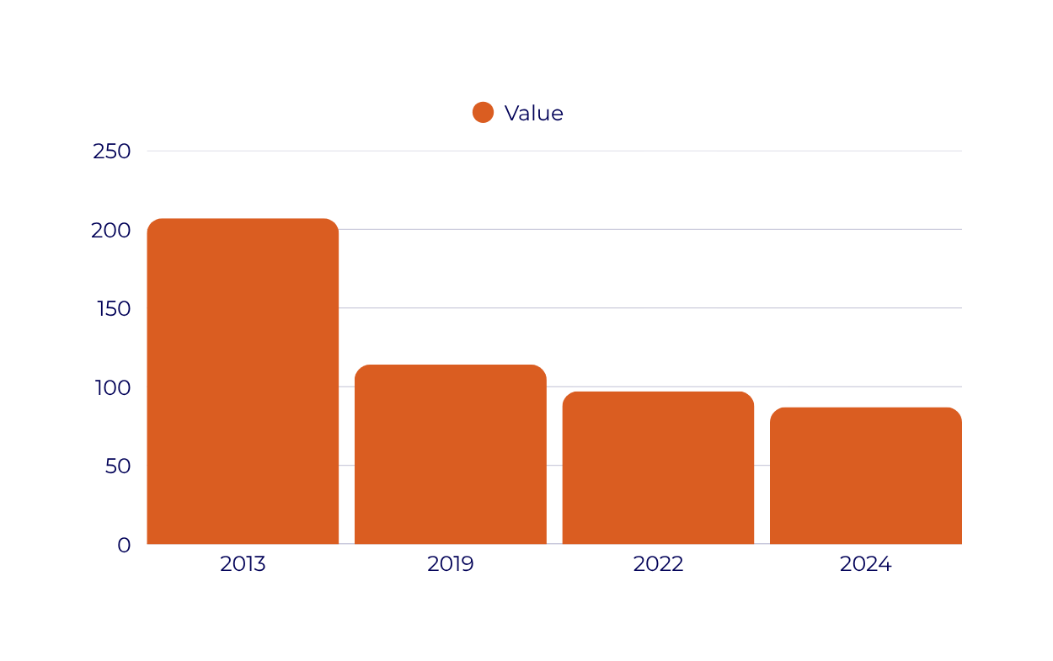
Nigeria Has Reduced ICT Access Gaps, But The Remaining Locations Are More Challenging
58%
Reduction in identified ICT gap clusters since 2013
207.0
The remaining 87 clusters still contain 23.37 million people
114.0
97.0
87.0
Next step
Map every polling unit against the remaining gaps
8th Nigeria eGovernment Summit | 10 September 2026
06
Notes:
This is a real success story: USPF studies show identified ICT gap clusters falling from 207 in 2013 to 87 in 2024. The remaining gaps are likely to require more targeted subsidy, shared infrastructure and alternative backhaul.
Sources:
https://www.uspf.gov.ng/clusters-of-ict-gap

Slide 6
WHAT BLOCKS 100% COVERAGE
The challenges are technical, commercial and institutional
CHALLENGE
OPERATIONAL EFFECT
RESPONSE
REMOTE LOCATION
Low traffic weakens normal commercial returns
Satellite, shared rural sites, outcome subsidy
WEAK OR NO GRID
Generator dependence raises cost and failure risk
Solar, batteries, efficient loads, remote monitoring
CONGESTION
A signal may exist but fail under election-day demand
Temporary capacity, priority design, multi-network routing
FRAGMENTED OWNERSHIP
Many agencies hold separate maps and contracts
One geospatial register and joint command structure
TRUST AND CYBER RISK
Unclear outages become contested narratives
Signed logs, status transparency, independent assurance
8th Nigeria eGovernment Summit | 10 September 2026
07
Notes:
Stress that no single technology solves the last mile. Remote sites face weak business cases, while urban sites may fail through congestion. Governance and transparency are as important as equipment.
Sources:
https://www.uspf.gov.ng/clusters-of-ict-gap
https://www.ncc.gov.ng/q4-2025-report

Slide 7
Four Polling-Unit Archetypes Need Different Solutions
URBAN DENSE
PERI-URBAN
RURAL CLUSTER
REMOTE / HARD TO REACH
Backhaul
Backhaul
Backhaul
Backhaul
Fibre or high-capacity microwave
Microwave or fibre where available
Shared rural site or fixed wireless
LEO or GEO satellite backhaul
Access
Access
Access
Access
Dual mobile networks
4G with multi-network SIM
4G or microwave relay
Satellite or hybrid terminal
Power
Power
Power
Power
Grid plus battery UPS
Solar-assisted battery
Solar plus battery
Standalone solar plus battery
Technology neutrality allows each location to use the lowest-cost option that meets the same service standard
08
Notes:
Recommend a location-based design. Technology neutrality should not mean standards neutrality. Every archetype must meet the same measured availability, security and recovery targets.
Sources:
https://www.uspf.gov.ng/clusters-of-ict-gap

Slide 8
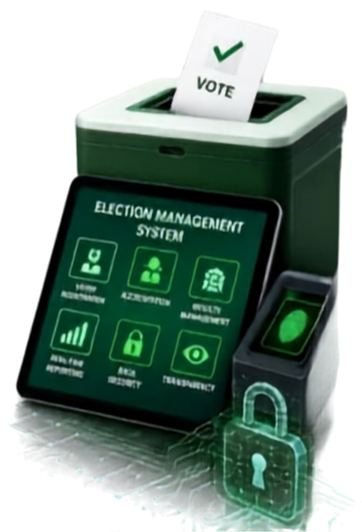
A Resilient Design Uses Independent Paths
PRIMARY
Best available 4G/5G or fixed wireless
POLLING UNIT
SECURE ELECTION SERVICES
BVAS
secure router
local transaction queue
Authentication
results upload
monitoring and audit
SECONDARY
A different mobile network
FALLBACK
Satellite for priority remote sites
Local queueing prevents a brief outage from becoming data loss. Independent paths prevent one operator failure from becoming a national incident
8th Nigeria eGovernment Summit | 10 September 2026
09
Notes:
Describe primary, secondary and fallback paths. The design should support store-and-forward with signed timestamps, so a temporary outage delays transmission but does not compromise evidence. Security architecture requires INEC validation.
Sources:
https://wp1.inecnigeria.org/wp-content/uploads/2023/02/2023-Election-Procedure-1.pdf

Slide 9
Every Polling Unit Needs An Energy Service Level
1
LOAD PROFILE
BVAS, router, phones, lighting and support equipment
2
AUTONOMY
Full operating window plus a defined reserve margin
3
RECHARGE
Solar or grid recharge sized for consecutive operating days
4
ASSURANCE
State of charge, tamper alert and remote health monitoring
Procure uptime as a service, with payment linked to tested availability and battery health
8th Nigeria eGovernment Summit | 10 September 2026
10
Notes:
Avoid prescribing one battery size nationally. Define loads, hours, reserve and recharge assumptions for each archetype. Procurement should pay for verified service rather than panels and batteries delivered.
Sources:
https://api.worldbank.org/v2/country/NGA/indicator/EG.ELC.ACCS.ZS?format=json&per_page=10

Slide 10













Success Requires Proof Before Election Day
90-60 DAYS
60-30 DAYS
30-7 DAYS
ELECTION DAY
AFTER POLLS
Survey and geocode
Remediate and rehearse
Load and failover tests
Joint operations
Audit and improve
Test signal, power and access constraints at every site
Install capacity, energy kits and fallback routes
Simulate peak traffic and loss of the primary network
Monitor sites, dispatch support and publish service status
Reconcile logs, incidents and results transmission times
A national dashboard should show readiness by polling unit without exposing sensitive network details
8th Nigeria eGovernment Summit | 10 September 2026
11
Notes:
Emphasise rehearsals. The first full-load test must not occur on election day. A joint operations centre should bring INEC, NCC, operators, power providers, security and field support into one incident process.
Sources:
https://www.ncc.gov.ng/q4-2025-report

Slide 11

One delivery model can align public and private capacity
INEC
INDEPENDENT ASSURANCE
Owns service standard, election workflow and acceptance
ENERGY PROVIDERS
Tests readiness, cybersecurity and published performance
NCC + USPF
Maps gaps, coordinates spectrum and targets subsidy
OPERATORS + INFRACOS
Deliver monitored solar, storage and maintenance
Provide access, backhaul, roaming options and field support
Shared geospatial data, one service specification and one incident vocabulary
Notes:
Propose a formal Polling Unit Connectivity and Energy Programme with INEC as service owner. NCC and USPF coordinate infrastructure evidence and market interventions. Independent assurance protects credibility.
Sources:
https://www.uspf.gov.ng/clusters-of-ict-gap
https://inecnigeria.org/

Slide 12
Funding should target the gap, not duplicate viable networks
Competitive procurement from existing operators
Pay per verified polling-unit service
COMMERCIAL COVERAGE
SHARED INFRASTRUCTURE
Co-investment where one asset can serve many sites
Open access and transparent wholesale terms
UNIVERSAL SERVICE GAP
Outcome subsidy for locations with no viable return
Reverse auction or least-subsidy competition
TEMPORARY CAPACITY
Short-term sites, satellite terminals and energy kits
Framework contracts activated for each election
Release payment after field test, monitored uptime and evidence submission
13
Notes:
The funding model should preserve competition. Use existing commercial networks first, shared assets where they improve economics, and targeted universal service support for the true gap. Contracts should reward availability.
Sources:
https://www.uspf.gov.ng/clusters-of-ict-gap

Slide 13

A Practical Path To 2027 Starts Now
Critical decision: approve the standard and national site survey early enough to fund remediation before the election timetable becomes compressed
ELECTION PERIOD
Q1 2027
Q1 2027
Q3 2026
Q4 2026
05
OPERATE
04
Run the joint command centre and publish performance
03
01
02
PROVE
SCALE
Complete full-load rehearsals, failover tests and assurance
BASELINE
PILOT
Create the polling-unit infrastructure register and service standard
Test representative sites across all six geopolitical zones
Procure remediation, shared infrastructure and energy service

Slide 14

Five Recommendations For Election-Grade Access
01
02
03
04
05
Procure monitored energy autonomy and service availability
Conduct national load, failover and public-transparency rehearsals
Adopt a Polling Unit Connectivity and Energy Standard
Publish a geospatial readiness baseline for every polling unit
Require two independent connectivity paths for priority sites
Notes:
The roadmap is deliberately front-loaded. By the time campaigns peak, the infrastructure baseline, contracts and tests should already exist. Pilots must represent difficult geography, not only convenient sites.
Sources:

Slide 15

The Democratic Value Of Technology Is Measured At The Point Where Every Citizen Meets The System
100% polling-unit coverage is achievable when Nigeria plans connectivity, energy and assurance as one service
Thank you
Adewumi Anjorin | Founder & Managing Director
Notes:
Close with confidence. Invite government, regulators and industry to commit to the standard, survey and pilot. The goal is not a perfect national network everywhere. The goal is a verified, resilient service at every polling unit when democracy needs it.
Sources:

