Slide 1
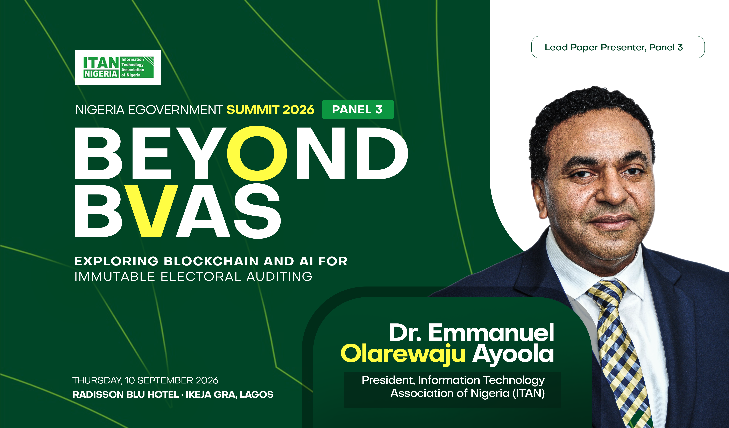

Slide 2
01 · CONTEXT
A decade of digitising trust
The question has evolved — the need for verifiable results has not.
2015
2019–23
2027?
SMART CARD READER
BVAS + IReV
WHAT NEXT?
Biometric card readers introduced; widely reported failures.
Bimodal accreditation + online result-viewing portal.
Blockchain-anchored audit
trails + AI anomaly detection
Panel 3 asks whether the layer after accreditation can become as
verifiable as the accreditation itself.
02
NIGERIA eGOVERNMENT SUMMIT 2026 · PANEL 3
02
NIGERIA eGOVERNMENT SUMMIT 2026 · PANEL 3

Slide 3


02 · ITAN’S PERSPECTIVE
Two technologies. Two different jobs.
BLOCKCHAIN
AI
FOR AUDIT
FOR AUDIT
Statistical and machine-learning models flag turnout or result patterns that deviate from expectation — for human officers to review.
A tamper-evident distributed ledger that anchors, timestamps and hashes each result sheet at the point of capture — making later alteration detectable.
NOT A DECISION-MAKER
NOT END-TO-END BLOCKCHAIN VOTING
Every flag is decision-support for a human, not an automatic ruling.
The focus is auditing the record, not casting the ballot electronically.
NIGERIA eGOVERNMENT SUMMIT 2026 · PANEL 3
03

Slide 4

03 · GLOBAL EVIDENCE
Proof the underlying idea works
20+ years
2018
12,347
10,000+
ESTONIA
SIERRA LEONE
COLORADO, USA
NASDAQ LINQ
KSI blockchain has secured national i-voting audit logs since 2005.
Agora ran an accredited blockchain shadow tally in the Western District.
Ballots processed in a 2024 municipal blockchain pilot for absentee voters.
Shareholder votes verified on blockchain annually since 2015.
REAL-WORLD SIGNAL
REAL-WORLD SIGNAL
REAL-WORLD SIGNAL
REAL-WORLD SIGNAL
Conclusion: Institutional proof exists — but national-election scale still demands Nigerian pilots, safeguards, and governance.
04
NIGERIA eGOVERNMENT SUMMIT 2026 · PANEL 3
04
NIGERIA eGOVERNMENT SUMMIT 2026 · PANEL 3

Slide 5

04 · NIGERIA’S STARTING POINT
We are not starting from zero.
105+
16.6M+
MAJORITY
Elections and by-elections ran on IReV before 2023
Registered voters already using IReV pre-2023
Of BVAS units performed reliably for accreditation
THE HONEST READING
BVAS largely did its core job: accreditation. The sharper problem was real-time transmission and upload at unprecedented volume — 530,538 result sheets.
530,538 RESULT SHEETS
05
NIGERIA eGOVERNMENT SUMMIT 2026 · PANEL 3
05
NIGERIA eGOVERNMENT SUMMIT 2026 · PANEL 3

Slide 6
05 · CHALLENGES
What we are actually up against
2023 exposed operational weaknesses. The next layer introduces new technical and governance constraints.
WHAT WENT WRONG IN 2023
WHAT BLOCKCHAIN + AI STILL STRUGGLE WITH
Real-time IReV upload failed at unprecedented volume
Trusted digital-ID foundation
Over 200 BVAS units lost or damaged nationwide
National-scale pilots and infrastructure
Network and connectivity gaps in rural and
insecurity-affected areas
Cost, internet penetration and legal-framework gaps
Human and process error compounded technical shortfalls
AI-generated disinformation as a new threat
The objective is not to replace the system — it is to make the existing chain more resilient, auditable and trusted.
06
NIGERIA eGOVERNMENT SUMMIT 2026 · PANEL 3
06
NIGERIA eGOVERNMENT SUMMIT 2026 · PANEL 3

Slide 7

06 · PROFFERED SOLUTIONS
Five moves that fit Nigeria’s starting point
01
02
03
ANCHOR, DON’T REPLACE
AI AS EARLY WARNING
COUNTER DISINFORMATION
Hash and timestamp each result sheet on a permissioned blockchain.
Flag anomalies for human review — never automatic disqualification.
Pair synthetic-media detection with rapid public-response capability.
04
05
PILOT BEFORE SCALE
CLOSE THE DATA GAP
Test in a by-election, aligned with the proposed 2027 mock election.
Co-develop biometric and audit-data rules with NDPC before deployment.
07
NIGERIA eGOVERNMENT SUMMIT 2026 · PANEL 3
07
NIGERIA eGOVERNMENT SUMMIT 2026 · PANEL 3

Slide 8
07 · RECOMMENDATIONS
Who does what, starting now
INEC
Complete the technology audit; test blockchain-anchored transmission
in the 2027 mock election.
01
NASS &
POLICYMAKERS
Recognize cryptographic audit trails in disputes; fund INEC technology adequately.
02
NDPC
Co-develop data-protection guardrails for biometric and blockchain-anchored audit data.
03
ITAN & IT
INDUSTRY
Create a national working group and build local engineering capacity.
04
08
NIGERIA eGOVERNMENT SUMMIT 2026 · PANEL 3
08
NIGERIA eGOVERNMENT SUMMIT 2026 · PANEL 3

Slide 9
08 · ITAN’S COMMITMENT
A standing offer — not just a paper
ITAN is ready to move from dialogue to capacity — and from capacity to execution.
01
02
03
CONVENE
CONTRIBUTE
BUILD LOCAL
A standing electoral-technology working group drawn from ITAN’s 350+ member companies.
Technical review capacity to INEC ahead of the 2027 audit and proposed mock election.
Champion Nigerian engineers as builders and auditors — not just end-users of imported systems.
Immutable auditing is a partnership between the umpire, the regulator and the industry that has to build and maintain it.
09
NIGERIA eGOVERNMENT SUMMIT 2026 · PANEL 3
09
NIGERIA eGOVERNMENT SUMMIT 2026 · PANEL 3

Slide 10

THANK YOU
!
Do you have any questions? Reach out via:
info@itan.org.ng | www.itan.org.ng
+234-802-3608653 | +234-802-3041367
Information Technology (Industry) Association of Nigeria (ITAN)
Information Technology Association of Nigeria ITAN
@itannigeria
33, Oyinkan Abayomi Drive, Ikoyi, Lagos
Suite 8, Siccons Plaza, Ahmadu Bello Way, Area 11 Garki, Abuja
NIGERIA eGOVERNMENT SUMMIT 2026 · PANEL 3
Lagos · 10 September 2026

