Slide 1

Protecting Digital Trust in Nigeria: Cybersecurity, Privacy and the Future of Citizen-Centric Governance
The security of an election is no longer confined to the polling booth. It extends to every device, database, identity, platform and piece of information that shapes a citizen's ability to participate
By: Dr. Harrison Nnaji

Slide 2

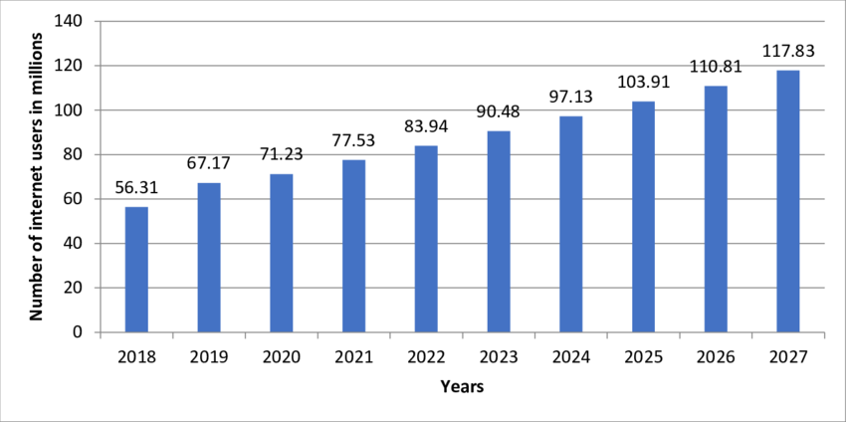
Nigeria at a Glance
ion's digital economy.
~4,700+ Weekly Attack Attempts
220+ Million People
110M+ Connected Citizens
Financial sector targets experience thousands of automated exploitation attempts per week, solidifying banking and fintech as the most heavily targeted industries in West Africa. - Checkpoint
Nigeria population is equivalent to 2.85% of the total world population ranking 6^{th.} 53.9 % of the population is urban and Median age in Nigerian is 17.9years - Statisca
Over 53% of Nigeria's population uses the internet. Rapid expansion in digital payments, USSD banking, and mobile connectivity continuously broadens the national attack surface. - Statisca
97 Million + INTERNET USERS
90% Workforce Talent Gap
₦25B+ Annual Fraud Losses
High emigration rates among skilled tech professionals ("Japa") leave organizations with severe shortages in specialized security operations and incident response staff. - ISC2
Confirmed financial sector losses from cyber-enabled fraud exceed tens of billions of Naira annually, driven by targeted credential theft, API exploits, and Business Email Compromise (BEC). - CBN ANti Fraud Report
Every Nigerian citizen is now a digital citizen. Protecting this footprint is no longer just about securing networks—it is about preserving trust in the nat

Slide 3

Nigeria’s Digital Trust Landscape
The Trust Paradox: While consumer adoption of digital channels is at an all-time high, exposure to phishing, social engineering, and payment fraud threatens user confidence across the ecosystem.
Massive Scale & Speed: Nigeria's digital economy is expanding rapidly, making digital platforms the primary interaction point for commerce, banking, and government services.
Every Nigerian citizen is now a digital citizen.
Every citizen leaves a digital footprint.
Every digital footprint is a target.
The future challenge is no longer just cybersecurity.It is protecting trust itself.
Economic Impact: Establishing and maintaining digital trust is essential to securing foreign direct investment, supporting open banking initiatives, and sustaining the broader fintech explosion.
Digital Transformation succeeds only when citizen trust the system that serve them: Cybersecurity is no just protecting Technology

Slide 4
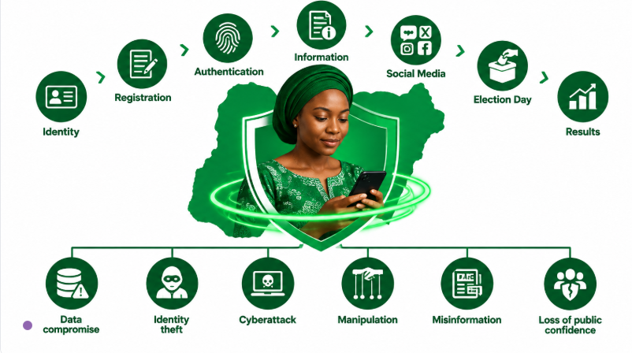
THE DIGITAL VOTER IS THE NEW PERIMETER
Protecting the voter means protecting the entire digital ecosystem around the voter.
Notes:
Every stage above creates opportunity for the below

Slide 5
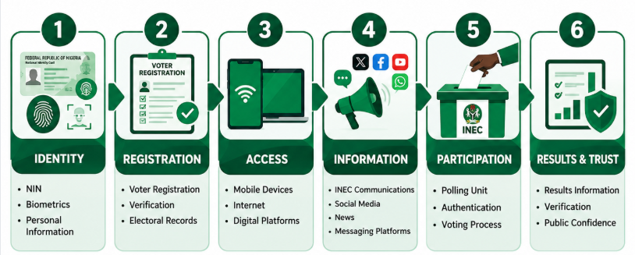
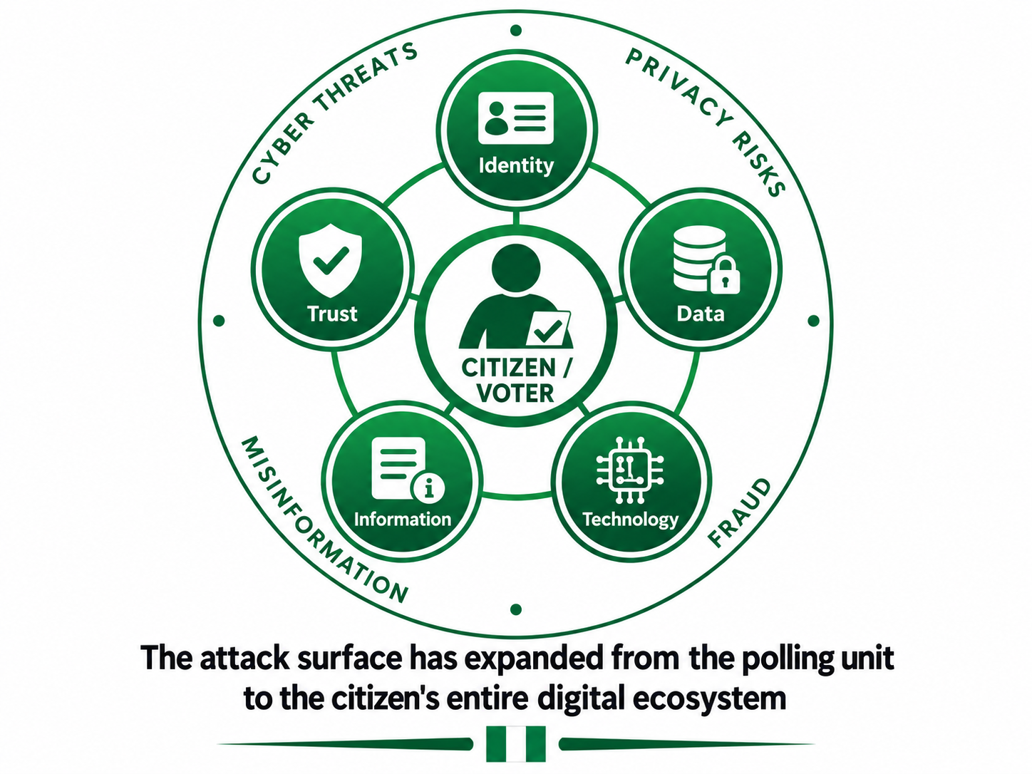
THE DIGITAL VOTER IS THE NEW PERIMETER
THE DIGITAL VOTER JOURNEY
Every connection creates a trust responsibility.
Their identity is registered, their data is stored, information reaches them through digital channels, and their perception of the election is increasingly shaped online.
The modern voter does not interact with the electoral system only at the polling unit.
The journey increasingly begins long before election day and continues through a network of digital identities, databases, devices, platforms and information channels.

Slide 6
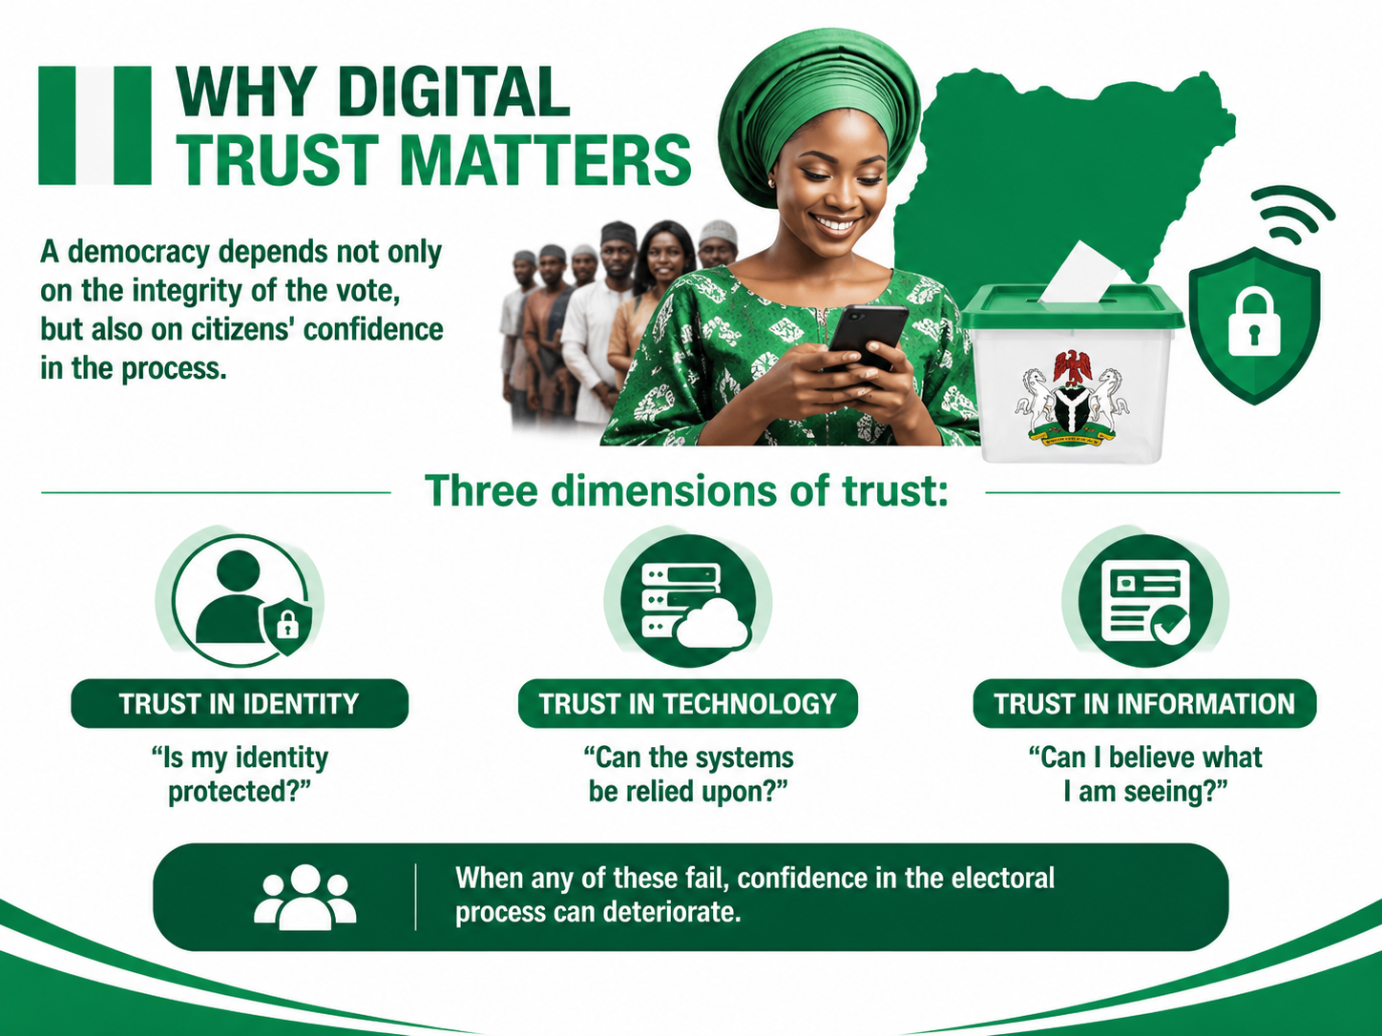
Why Trust Matter
Notes:
When we talk about election security, we often focus on whether the technology is secure. But security is only one component of trust.
A citizen must first trust that their identity is protected. They must trust that the technology supporting the electoral process is reliable and resilient. And increasingly, they must trust the information they are receiving.
Consider what happens when these three things fail.
If my identity is compromised, I question whether I can participate safely. If the technology is compromised, I question whether the process can be relied upon. And if the information environment is compromised, I may no longer know what is true.
That is the real challenge. An election can be technically secure and still lose public trust if citizens cannot distinguish reality from manipulation.
So digital trust is bigger than cybersecurity. It is about protecting the integrity of the entire citizen experience.

Slide 7
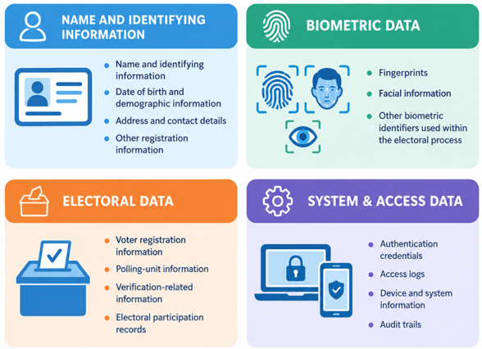
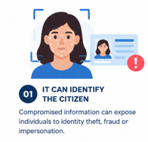
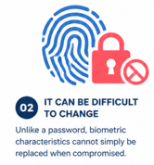
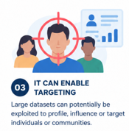
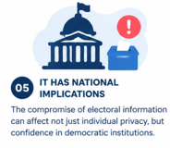
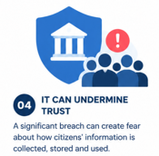
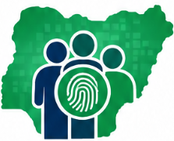
Why Trust Matter
WHAT ARE WE PROTECTING?
WHY IS THIS DATA SO SENSITIVE?
~94 MILLION
Nigerian identities referenced by the NDPC in its 2026 strategic collaboration with INEC - April 15, 2026, NDPC A voter database is not simply a collection of records. Behind every record is a citizen, an identity and a democratic right . The question is, ‘How do we protect the citizen throughout the entire lifecycle of their data?’

Slide 8
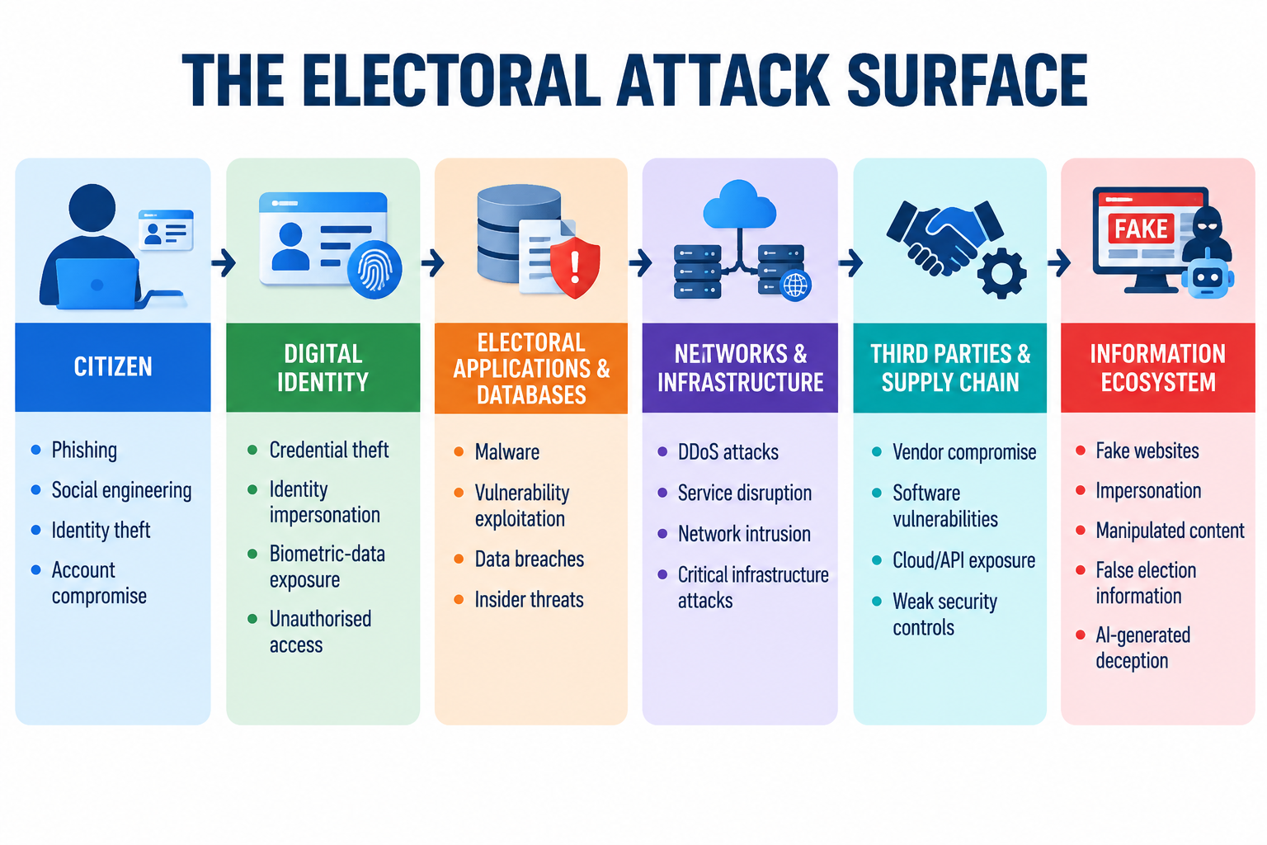
The Electoral Attack Surface
The Election Attack Surface Is Bigger Than the Election System.
The digital voter interacts with an ecosystem of identities, applications, networks, databases, devices, people and information platforms. The Shift moves from How do we prevent every attack? To “How do we ensure that an attack cannot compromise the integrity, availability or credibility of the electoral process?”
Notes:
From a cybersecurity perspective, we have to stop thinking about the election as a single system.
The attack surface is much larger.
It includes the citizen's device, identity, applications, databases, networks, technology providers, communication channels and the information ecosystem around the election.
An attacker does not necessarily need to compromise the core electoral system to cause damage.
They may compromise a person's identity. They may impersonate an institution. They may disrupt a service. They may compromise a third-party provider. Or they may simply inject false information into the information environment.
And that brings us to an important distinction.
Cybersecurity is traditionally concerned with confidentiality, integrity and availability. But in an election, we must add authenticity.
Citizens need to know not only that the system is available, but that the information they are receiving is genuinely from the institution they believe it is from.
So our objective cannot simply be to prevent every attack. That is an unrealistic standard.
Our objective is to build an electoral ecosystem that can anticipate, resist, detect, respond to and recover from attacks without losing public confidence.
That is what cyber resilience means.”

Slide 9
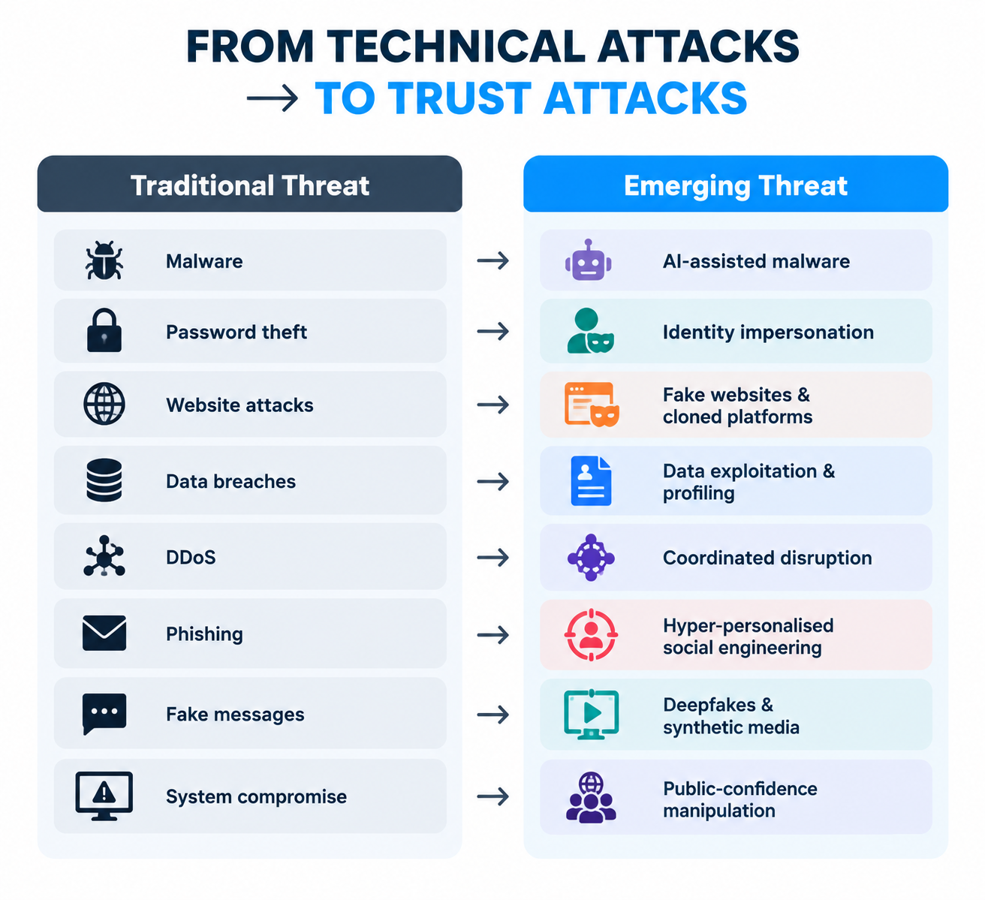

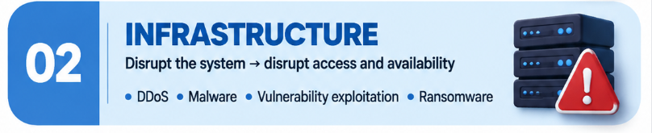

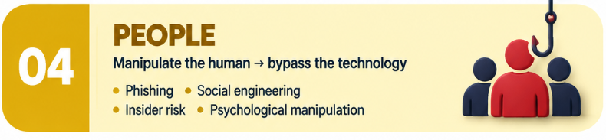

THE THREAT LANDSCAPE HAS CHANGED
Election Threats Are No Longer Just About Hacking Systems
The most damaging attack may not be the one that takes a system offline. It may be the one that makes citizens believe the system cannot be trusted
Notes:
From a cybersecurity perspective, we have to stop thinking about the election as a single system.
The attack surface is much larger.
It includes the citizen's device, identity, applications, databases, networks, technology providers, communication channels and the information ecosystem around the election.
An attacker does not necessarily need to compromise the core electoral system to cause damage.
They may compromise a person's identity. They may impersonate an institution. They may disrupt a service. They may compromise a third-party provider. Or they may simply inject false information into the information environment.
And that brings us to an important distinction.
Cybersecurity is traditionally concerned with confidentiality, integrity and availability. But in an election, we must add authenticity.
Citizens need to know not only that the system is available, but that the information they are receiving is genuinely from the institution they believe it is from.
So our objective cannot simply be to prevent every attack. That is an unrealistic standard.
Our objective is to build an electoral ecosystem that can anticipate, resist, detect, respond to and recover from attacks without losing public confidence.
That is what cyber resilience means.”

Slide 10
1
Huge Data Theft
Regulatory Compliance Breach
4
2
Consequences
of Cyber Breaches
5
Financial Loss
Operational Disruption
3
Reputational Damage
Compromised System
6

Slide 11
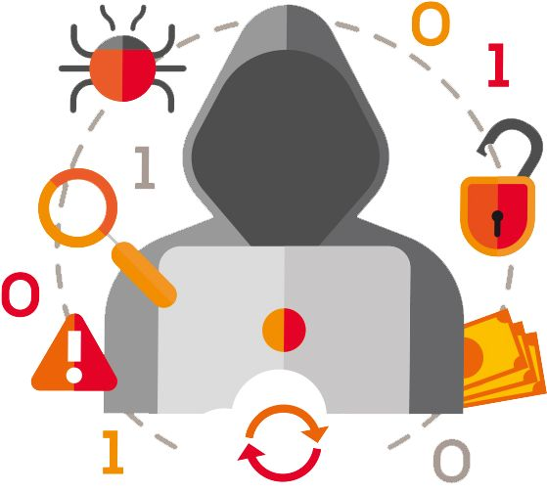
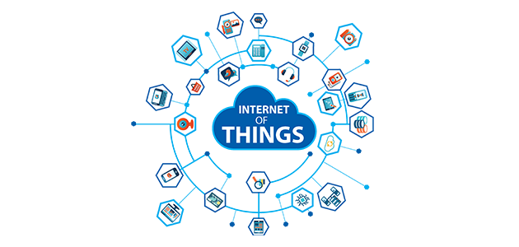


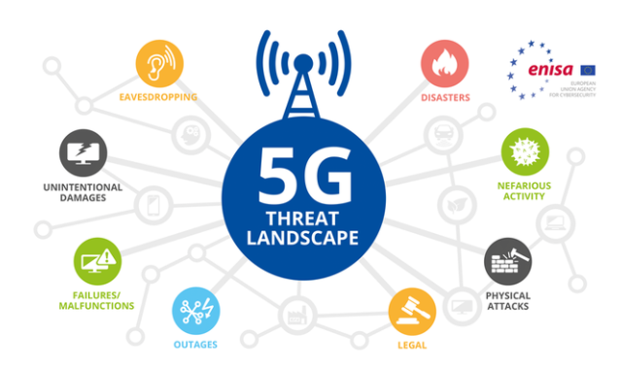
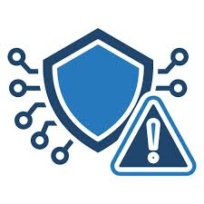

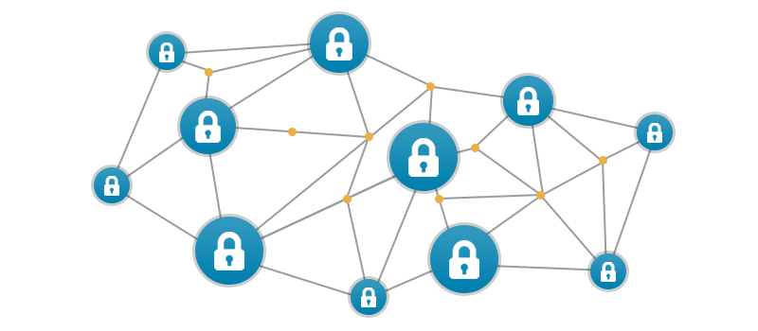


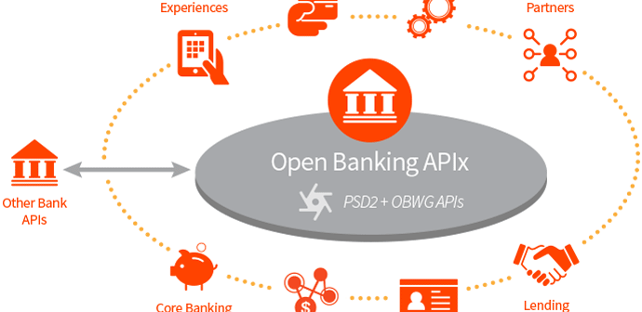
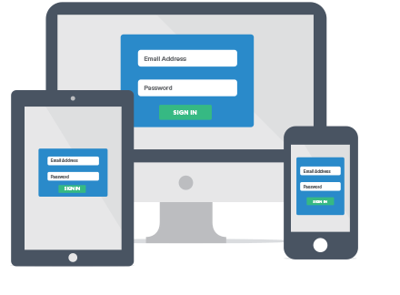
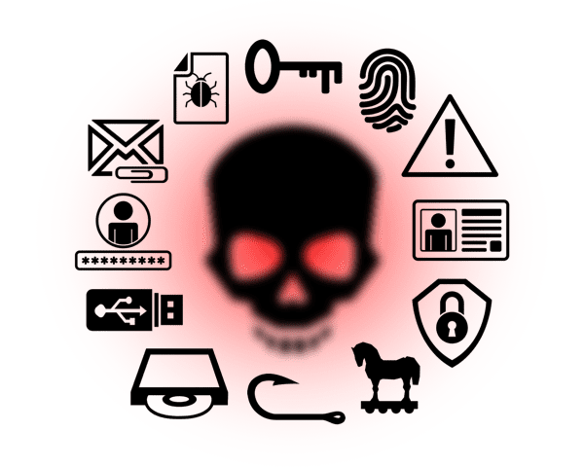
Cybersecurity in Digitalization Era
Internet of Things
Big Data/ Cognitive Capabilities
5G
Cloud
CYBERSECURITY
Blockchain
Artificial Intelligence
Open APIs
Mobility/Remo
In the digitalization era, where technologies are deeply integrated into everyday life and business operations, the code of cybersecurity serves as a fundamental framework and shield to protect against emerging threats.

Slide 12

Nigeria Governments and Cybersecurity Concerns

Slide 13
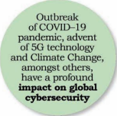
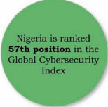
Nigeria Cyber Vulnerability
Third Party Threat: The country relies largely on foreign ICT solutions
Low Cybersecurity Awareness: The nation recorded low cyber security awareness as against the fast –growing pace of cyber threats
Skilled Human Resource Gap
ITUGCI, 2018
The National Cybersecurity Coordination Centre (NCCC) identified some area of weakness in the Nations Cyberinfrastructure. This was a reported documented in 2019 by World Bank Digital Economy

Slide 14
National Cybersecurity Policy and Strategy 2014 – The Cybercrimes (Prohibition , Prevention etc.)
ITUGCI, 2018
CPA – Act 2015 , The Nigerian Data Protection Regulation 2019
Nigeria Cyber strength
National Broadband Plan 2020 – 2025 and National Digital Economic Policy and Strategy 2020 – 2030
Programs , Initiatives and Framework spearheaded by Government to enhance National Cyber Security
Proactive and Informed Private Sector – They play leading role in the regional and indeed global cybersecurity solution market-
Nigeria Collaborates with partners such as ECOWAS commission and Organized Crime (OCWAR-C) to further enhance Cybersecurity
Despite the current cyber threat profile, Nigeria has a strong commitment to defend her citizen, safeguard operations of critical infrastructure and ensure continuity services.
In 2018, Nigeria had its Cybersecurity Risk Assessment with collaboration of other international partners
NCCC

Slide 15
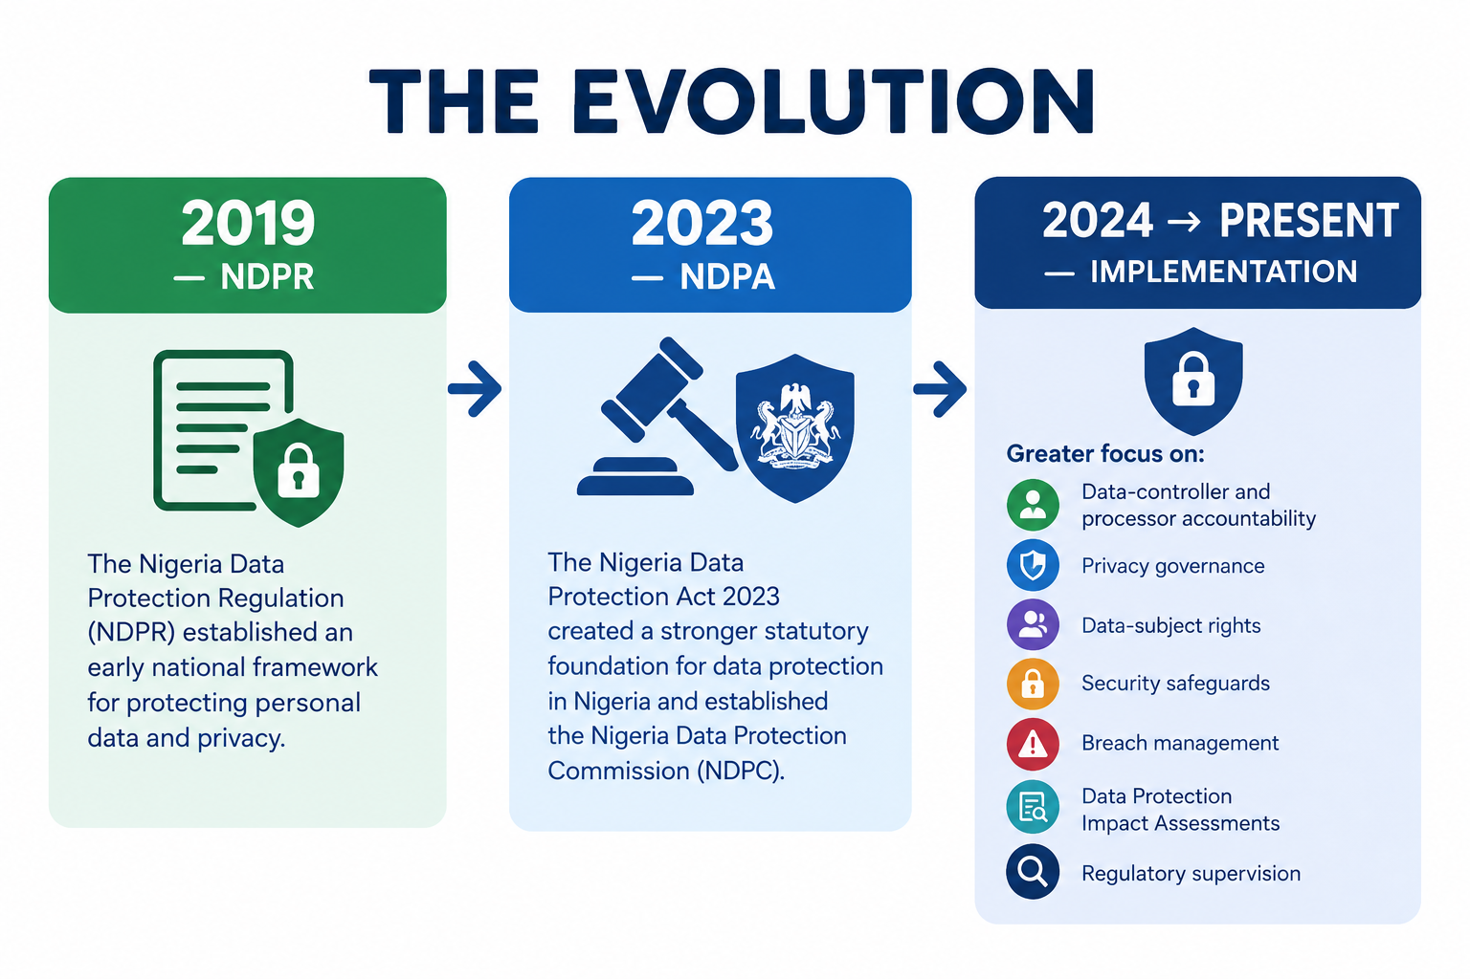
NIGERIA'S DATA PROTECTION JOURNEY - The Evolution
Nigeria's data-protection journey has evolved from a primarily regulatory focus toward a broader objective: Protecting the Citizen in a Digital Economy
WHAT THE NDPA MEANS FOR THE DIGITAL VOTER:
RIGHTS: Citizens have rights concerning how their personal data is processed.
ACCOUNTABILITY: Organisations processing personal data have responsibilities.
SECURITY: Appropriate technical and organisational measures are required to protect personal data.
TRANSPARENCY: Citizens should understand how their information is processed.
GOVERNANCE
: Privacy must become part of institutional decision-making—not an afterthought.

Slide 16
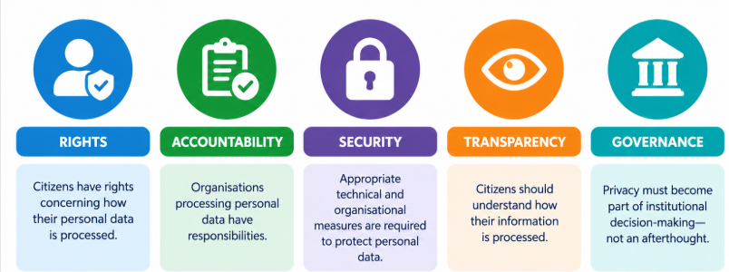
NDPA Means FOR THE DIGITAL VOTER?
The Nigeria Data Protection Act gives us the foundation. Digital trust requires us to build the culture, capabilities and controls that make that protection real. Do we know what data we hold? Do we know why we hold it? Who can access it? How is it protected? How long is it retained? What happens when a third party processes it? And what happens when there is a breach?
This is where the role of cybersecurity becomes inseparable from privacy.
Privacy establishes the citizen's rights. Cybersecurity provides many of the controls that help protect those rights. Governance creates accountability.
Nigeria's next step is not simply stronger compliance. It is building a culture of digital trust.”

Slide 17
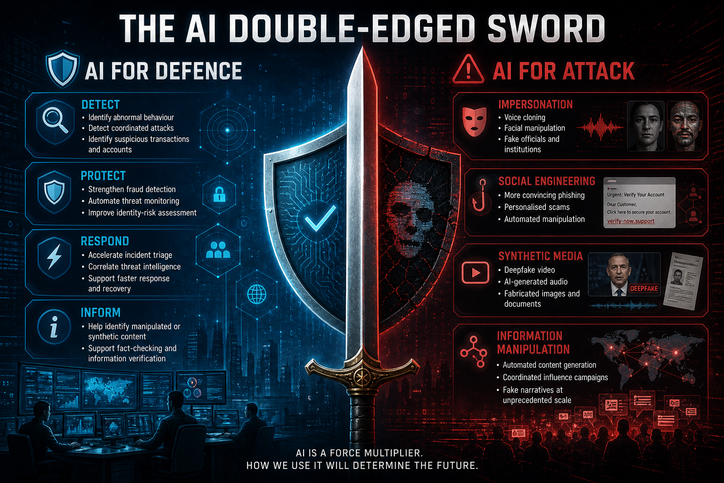
AI: THE NEW TRUST FRONTIER

Slide 18
AI: THE NEW TRUST FRONTIER Contd.
WHAT THIS MEANS FOR THE DIGITAL VOTER
A citizen could encounter:
A fake INEC announcement
A cloned voice of a public official
A manipulated political video
A fabricated election result
Thousands of automated social-media posts reinforcing the narrative
THE RESPONSE: BUILD AUTHENTICITY
Nigeria's digital ecosystem should increasingly rely on:
VERIFIED SOURCES: Citizens know where official information originates.
AUTHENTICATED COMMUNICATION: Critical announcements can be verified.
CONTENT PROVENANCE: Where appropriate, citizens can establish the origin of digital content.
RAPID RESPONSE: False information is identified and addressed quickly.
DIGITAL LITERACY: Citizens understand that seeing—and even hearing is no longer sufficient evidence of authenticity.
The technology does not need to change the vote.
IT CAN CHANGE WHAT PEOPLE BELIEVE ABOUT THE VOTE.
In an age where AI can manufacture convincing reality, digital trust will increasingly depend on our ability to prove authenticity.”
THE NEW SECURITY OBJECTIVE: Protect the system, Protect the data, Protect the identity, Protect the information.
PROVE WHAT IS REAL.

Slide 19
National Vulnerability Management (NVA)
Assist Government in appreciating the level of preparedness, need to safeguard huge investment in information system =s and communications infrastructure as well as commitment made to global partner national ICT development goals
1.
Identify , analyze and assess threats to CNII to facilitate effective risk management and mitigation
2.
Set the path for the adoption of security by Design practices as an approach to build security measure into CNII
Pave a patch for the documentation and archiving of all vulnerabilities. Create a National record to this effect and review periodically.
3.
4.
NVA shall be periodically conducted and integrated into the CNIIPP, NCCC in collaboration with sectoral CSIRTs shall coordinate the NVA with a view to determine National Cyber weakness.
NCCC
Notes:
1. Identify non-tolerable events and critical assets - To ensure the cyber-resilience of a company, it is necessary first of all to analyze the main risks and draw up a list of non-tolerable events that could cause significant damage to its activities. This step will help identify critical assets and focus on protecting the most valuable resources.
2. Monitor incidents and respond to cyberthreats - Incident monitoring and detection systems are needed to respond to potential threats and attacks in a timely manner. For this purpose, we recommend using SIEM systems that collect and analyze information about security events from various sources in real time. Together with XDR (extended threat detection and response) and NTA (network traffic analysis) solutions, this will help detect attacks in the early stages and ensure swift responses, reducing risks for your organization.
3. Evaluate cybersecurity effectiveness - The effectiveness of adopted cybersecurity measures should be regularly tested to assess the performance of the strategy and defenses. We recommend paying special attention to verification of the events non-tolerable for the organization.
4. Train employees and develop information security specialists - To effectively combat cyberthreats, African organizations should invest in the development of their cybersecurity experts. Regular training and certification of cybersecurity employees will enhance their skills and knowledge, boosting the company with expert support in preventing and responding to cyberattacks

Slide 20
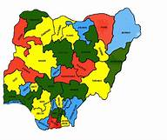
National Cybersecurity Policy Consideration
The security and wellbeing of the Nigerian people is as important in the cyber domain as it is in the physical domain
Cybersecurity is a critical enabler of economic progression and development
Technology development is critical to the attainment of Nigeria’s national priorities
Reginal and international collaboration is central and critical to cybersecurity
In 2019, Nigeria Government outlined 3 cardinal national objectives; Protecting National Security, Strengthening Economics Development and Fighting corruption. The National Cybersecurity Policy and strategy supported with above objectives. NCCC

Slide 21
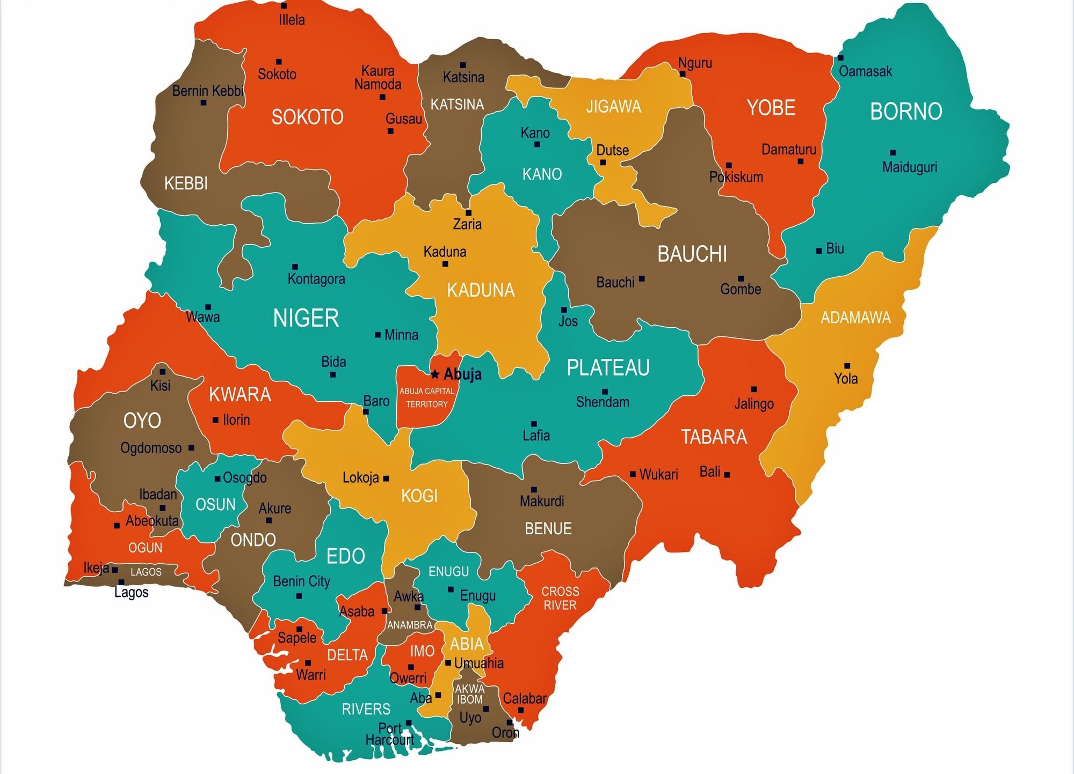
Recommendations to Strengthen Nigeria Against Cybercrime

Slide 22
Policy Recommendations for Addressing Cybersecurity Concerns in Nigeria
01
Establish an enforcement mechanism that strengthens accountability for failure to comply with the Convention
02
Learn from strategies in other continents such as Europe and make Malabo Convention binding among member as a treaty on Cybercrime
03
Enhance digital equality by provide an equilibrium in terms of digital capacity and infrastructure
04
Prioritize building cyber diplomacy to promote African interests in cyber diplomatic processes
05
Promote cybersecurity literacy and skills by developing cyber curricula which can be administered in tertiary institutions, public institutions, and specialized institutions
06
Africa should integrate artificial intelligence into their cyber-resilience frameworks, to enhance automated cyber-threat identification, cyber-attack response and system protection.
07
Develop coordinated cross-border systems for payments, ensuring harmonization of data systems and place cyber security at the top of economic agendas
08
All stakeholders should promote good cyber hygiene and resilience

Slide 23
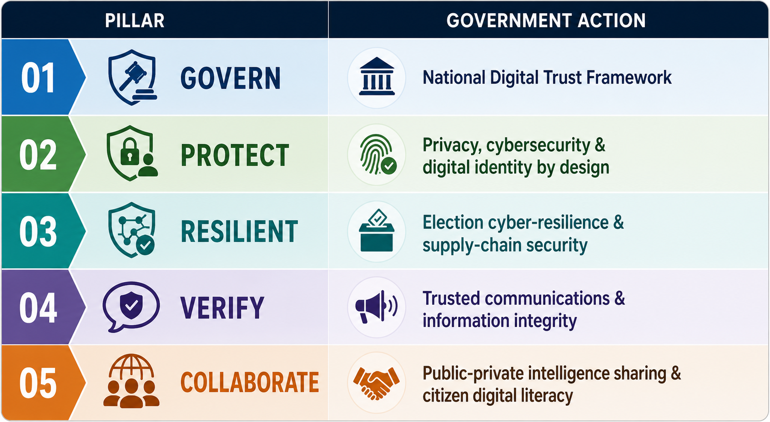
Build Trust into the Digital Democracy Infrastructure- Recommendation to the Government
FROM DIGITAL GOVERNMENT → TO TRUSTED DIGITAL GOVERNMENT

Slide 24
Increase Quality Cybersecurity Awareness Engagements
Cybersecurity courses for primary and secondary education should be enacted
Public awareness campaign for persons with disabilities and older people should be top priority
Increased focus on small and medium-sized enterprises (SMEs), private sector, and government cyber awareness.
Governments should recognize and sponsor the need for sector-specific educational programmes and training for cybersecurity professionals.
2.
3.
5.
1.
The world commemorated Cybersecurity Awareness Month in October and throughout the year, it remains important to discuss the challenges that Africa is faced with and strategies for what can be done to achieve cyber resilience.
4.

Slide 25

Improve Cybersecurity Hiring Process
1
Revamp recruitment processes and criteria
2
Offer competitive salaries and benefits
There's a staggering shortage of 3.5 million cybersecurity professionals. This shortage is acutely felt on the African continent due to various challenges
- Information System Security Certification Consortium (ISC)² Cybersecurity Workforce Study 2022
3
Collaborate to expand the talent pool
4
Develop in-house talent
5
Embed advanced tech for security
6
Outsource cybersecurity if required

Slide 26
Final Thoughts
Strengthening the legal framework for addressing cybercrime by enacting and enforcing laws that criminalize cybercrime and provide for appropriate penalties
Encouraging the development of a robust cybersecurity industry by providing incentives for cybersecurity startups and investing in research and development.
Improving the capacity of law enforcement agencies to investigate and prosecute cybercrime by providing them with the necessary training, equipment, and resources.
Addressing the root causes of cybercrime, such as poverty and unemployment, by creating more job opportunities and improving the economic situation in the country.
Enhancing international cooperation and collaboration in the fight against cybercrime by working with other countries to share information and intelligence, and to extradite cyber criminals.
Design controls around the acceptable use and Privacy of data using AI
Raising public awareness about the dangers of cybercrime and how to protect oneself from it by launching public education campaigns and providing cybersecurity training to individuals and organizations.
Embed cyber security considerations and concepts at their conception phases in regional initiatives.

Slide 27


Slide 28


Slide 29
References
https://www.worldometers.info/world-population/nigeria-population/#:~:text=The%20current%20population%20of%20Nigeria,latest%20United%20Nations%20data1.
https://nigerianstat.gov.ng/elibrary/read/1241549#:~:text=Nigeria's%20Gross%20Domestic%20Product%20(GDP,of%202024%20growth%20of%202.98%25.
https://www.statista.com/statistics/1268372/literacy-rate-in-nigeria/
https://arxiv.org/html/2402.01649v1#bib.bib12
Nigeria’s unemployment rate increased to 5.3% in Q1 2024, says NB
Cybersecurity in Nigeria’s digital age: Securing the future of our nation - Tribune Online
Over 50% of Nigeria's population live in poverty, says World Bank
How cyber-attacks exposed Nigeria’s IT security vulnerability in 2023 - Daily Trust
Nigeria Corruption Rank
(PDF) Emerging Trends in Cybercrime Awareness in Nigeria

Slide 30
https://www.statista.com/
https://nigeriacommunicationsweek.com.ng/2026/01/15/nigeria-targeted-with-4622-cyber-attacks-per-week-in-december-2025
https://nigeriacommunicationsweek.com.ng/2026/01/15/nigeria-targeted-with-4622-cyber-attacks-per-week-in-december-2025
https://oakinterlink.com/nigerian-companies-face-4388-cyber-attacks-per-week-why-building-cyber-aware-teams-is-now-important/
https://guardian.ng/features/executive-briefs/japa-wave-how-nigerias-banking-sector-can-confronts-talent-flight-adesina/
https://www.nigeriahousingmarket.com/news/fraudsters-rake-in-n134-48-billion-from-banks-customers-cbn
https://www.researchgate.net/figure/Number-of-internet-users-in-Nigeria-2018-to-2028-with-forecast-from-2023-to-2027-in_fig1_379550344

Slide 31
References
38507-doc-dts-english.pdf
Cybersecurity in Nigeria’s digital age: Securing the future of our nation - Tribune Online
(PDF) Cyber Security Issues in Nigeria and Challenges
https://punchng.com/nigeria-records-second-highest-cyberattacks-in-africa-says-kaspersky/
24COM005030-AJFOC_Africa Cyberthreat Assessment Report_2024_complet.pdf
What is the National Cybersecurity Policy and Strategy of 2021?
cybersecurity-strategy.pdf
NCPS 2020 Secretariat Final Copy 5 feb 21 curved.cdr
bing.com/ck/a?!&&p=366cb6fed3444d94JmltdHM9MTczMDA3MzYwMCZpZ3VpZD0yYmJiMDM3Yy05OWUyLTY3MzMtMzYyYi0xMWNiOTg5MDY2NTcmaW5zaWQ9NTI4MQ&ptn=3&ver=2&hsh=3&fclid=2bbb037c-99e2-6733-362b-11cb98906657&psq=Business+Software+Alliance+report+on+unlicensed+softwraed+usage+in+nigeri+a&u=a1aHR0cHM6Ly93d3cucmlwcGxlc25pZ2VyaWEuY29tL3ZhbHVlLW9mLXVubGljZW5zZWQtc29mdHdhcmUtaW4tbmlnZXJpYS1kcm9wcy10by0xMjMtbWlsbGlvbi8&ntb=1

